Slide 1
Stoner-Wohlfarth Theory
“A Mechanism of Magnetic Hysteresis in Heterogenous Alloys”
Stoner E C and Wohlfarth E P (1948), Phil. Trans. Roy. Soc. A240:599–642
Prof. Bill Evenson, Utah Valley University

Slide 2
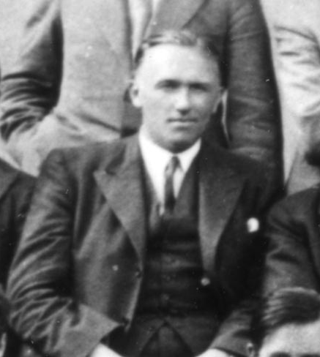
E.C. Stoner, c. 1934
E. C. Stoner, F.R.S.
and E. P. Wohlfarth (no
photo)
(Note:
F.R.S. = “Fellow of the Royal Society”)
Courtesy of AIP Emilio Segre Visual Archives

Slide 3
Stoner-Wohlfarth Motivation
How to account for very high coercivities
Domain wall motion cannot explain
How to deal with small magnetic particles (e.g. grains or imbedded magnetic clusters in an alloy or mixture)
Sufficiently small particles can only have a single domain

Slide 4
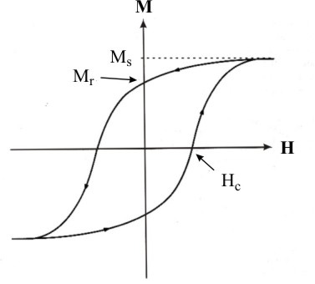
Hysteresis loop
M_{r} = Remanence
M_{s} = Saturation Magnetization
H_{c} = Coercivity

Slide 5
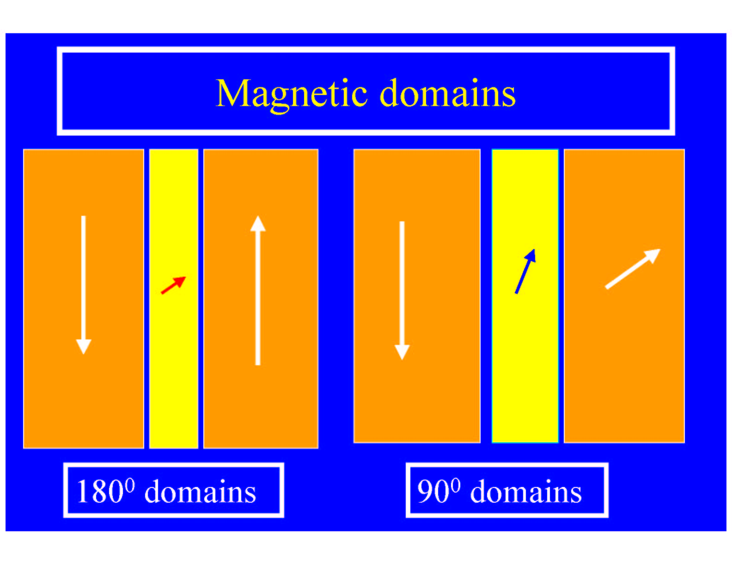
Domain Walls
Weiss proposed the existence of magnetic domains in 1906-1907
What elementary evidence suggests these structures?
www.cms.tuwien.ac.at/Nanoscience/Magnetism/magnetic-domains/magnetic_domains.htm

Slide 6
Stoner-Wohlfarth Problem
Single domain particles (too small for domain walls)
Magnetization of a particle is uniform and of constant magnitude
Magnetization of a particle responds to external magnetic field and anisotropy energy

Slide 7
Not Stoner Theory of Band Ferromagnetism
The Stoner-Wohlfarth theory of hysteresis does not refer to the Stoner (or Stoner-Slater) theory of band ferromagnetism or to such terms as “Stoner criterion”, “Stoner excitations”, etc.

Slide 8

Small magnetic particles

Slide 9
Why are we interested? (since 1948!)
Magnetic
nanostructures!
Can be single domain, uniform/constant magnetization, no long-range order between particles, anisotropic.

Slide 10
Physics in SW Theory
Classical e & m (demagnetization fields, dipole)
Weiss molecular field (exchange)
Ellipsoidal particles for shape anisotropy
Phenomenological magnetocrystalline and strain anisotropies
Energy minimization

Slide 11
Outline of SW 1948 (1)
1. Introduction
review of existing theories of domain wall motion (energy, process, effect of internal stress variations, effect of changing domain wall area – especially due to nonmagnetic inclusions)
critique of boundary movement theory
Alternative process: rotation of single domains (small magnetic particles – superparamagnetism) – roles of magneto-crystalline, strain, and shape anisotropies

Slide 12
Outline of SW 1948 (2)
2. Field Dependence of Magnetization Direction of a Uniformly Magnetized Ellipsoid – shape anisotropy
3. Computational Details
4. Prolate Spheroid Case
5. Oblate Spheroid and General Ellipsoid

Slide 13
Outline of SW 1948 (3)
6. Conditions for Single Domain Ellipsoidal Particles
7. Physical Implications
types of magnetic anisotropy
magnetocrystalline, strain, shape
ferromagnetic materials
metals & alloys containing FM impurities
powder magnets
high coercivity alloys

Slide 14
Units, Terminology, Notation
E.g.
Gaussian e-m units
1 Oe = 1000/4π × A/m
Older terminology
“interchange interaction energy” = “exchange interaction energy”
Older notation
I₀ = magnetization vector

Slide 15
Mathematical Starting Point
Applied field energy
Anisotropy energy
Total energy
(what should we use?)
(later, drop constants)

Slide 16
MAGNETIC ANISOTROPY
Shape anisotropy (dipole interaction)
Strain anisotropy
Magnetocrystalline anisotropy
Surface anisotropy
Interface anisotropy
Chemical ordering anisotropy
Spin-orbit interaction
Local structural anisotropy

Slide 17
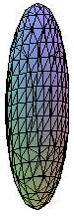
Ellipsoidal particles
This gives shape anisotropy – from demagnetizing fields (to be discussed later if there is time).
Spherical particles would not have shape anisotropy, but would have magnetocrystalline and strain anisotropy – leading to the same physics with redefined parameters.

Slide 18
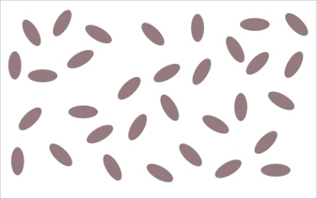
Ellipsoidal particles
We will look at one ellipsoidal particle, then average over a random orientation of particles.
The transverse components of mag-netization will cancel, and the net magnetiza-tion can be calculated as the component along the applied field direction.

Slide 19
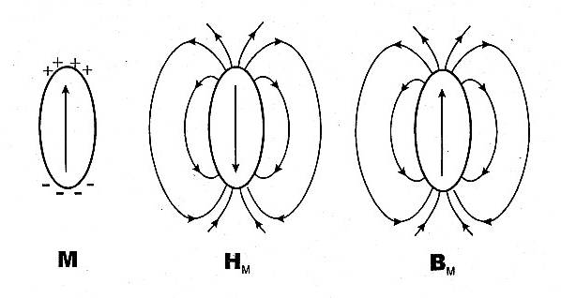
Demagnetizing fields → anisotropy
from Bertotti

Slide 20
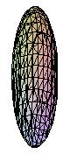
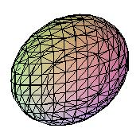
Prolate and Oblate Spheroids
These show all the essential physics of the more general ellipsoid.

Slide 21
How do we get hysteresis?
I₀
Easy Axis
H

Slide 22
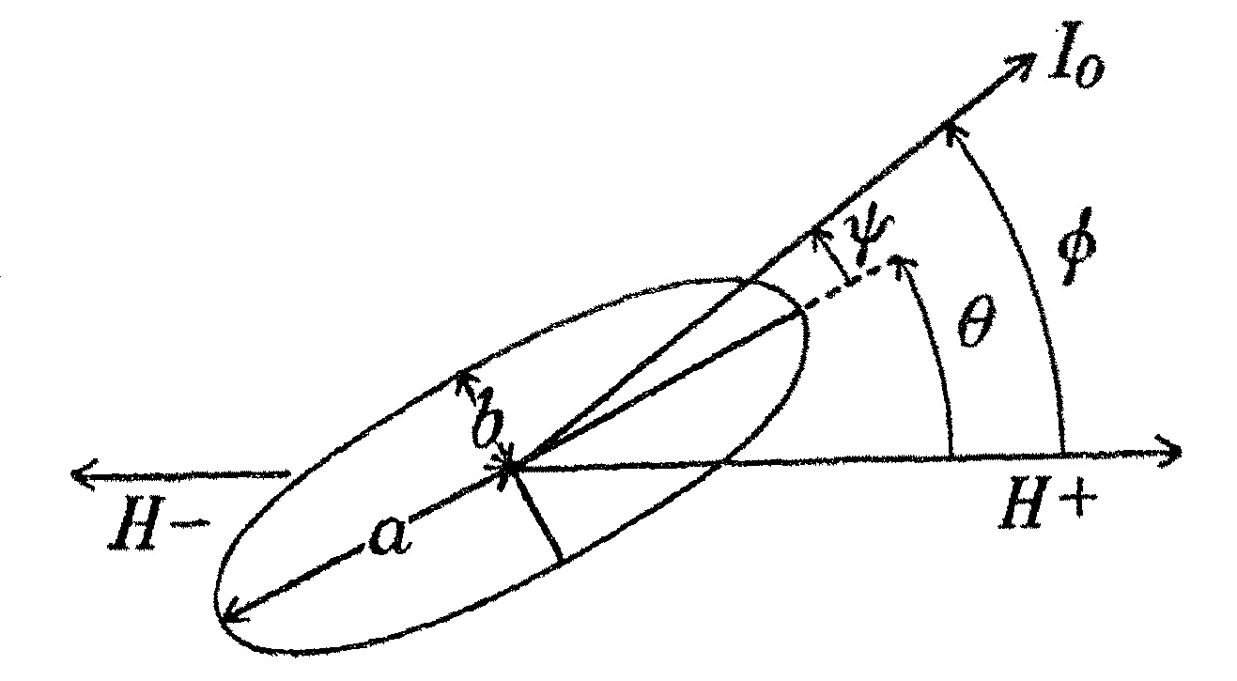
SW Fig. 1 – important notation
One can prove (SW outline the proof in Sec. 5(ii)) that for ellipsoids of revolution H, I₀, and the easy axis all lie in
a plane.

Slide 23
No hysteresis for oblate case
I₀
Easy Axis
360º degenerate
H

Slide 24
Mathematical Starting Point - again
Applied field energy
Anisotropy energy
Total energy
(later, drop constants)

Slide 25
Dimensionless variables
Total energy: normalize to and drop constant term.
Dimensionless energy is then

Slide 26
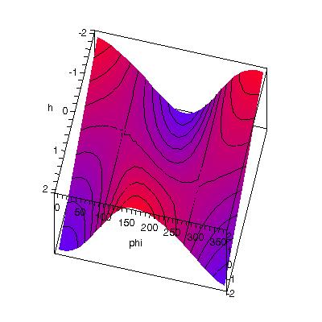
Energy surface for fixed θ
θ = 10º

Slide 27
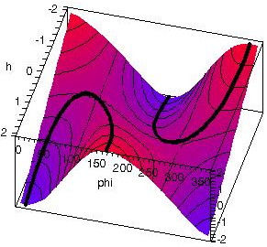
Stationary points (max & min)
θ = 10º

Slide 28
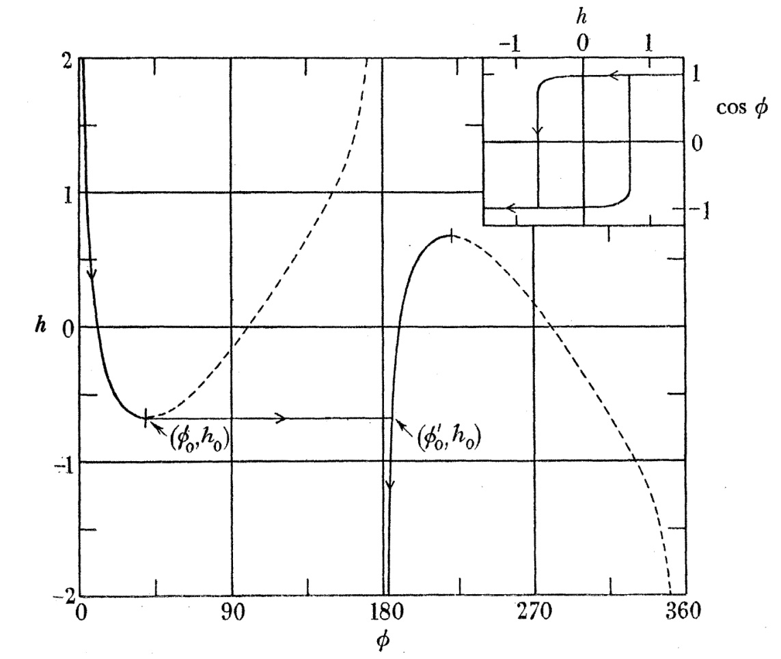
SW Fig. 2

Slide 29
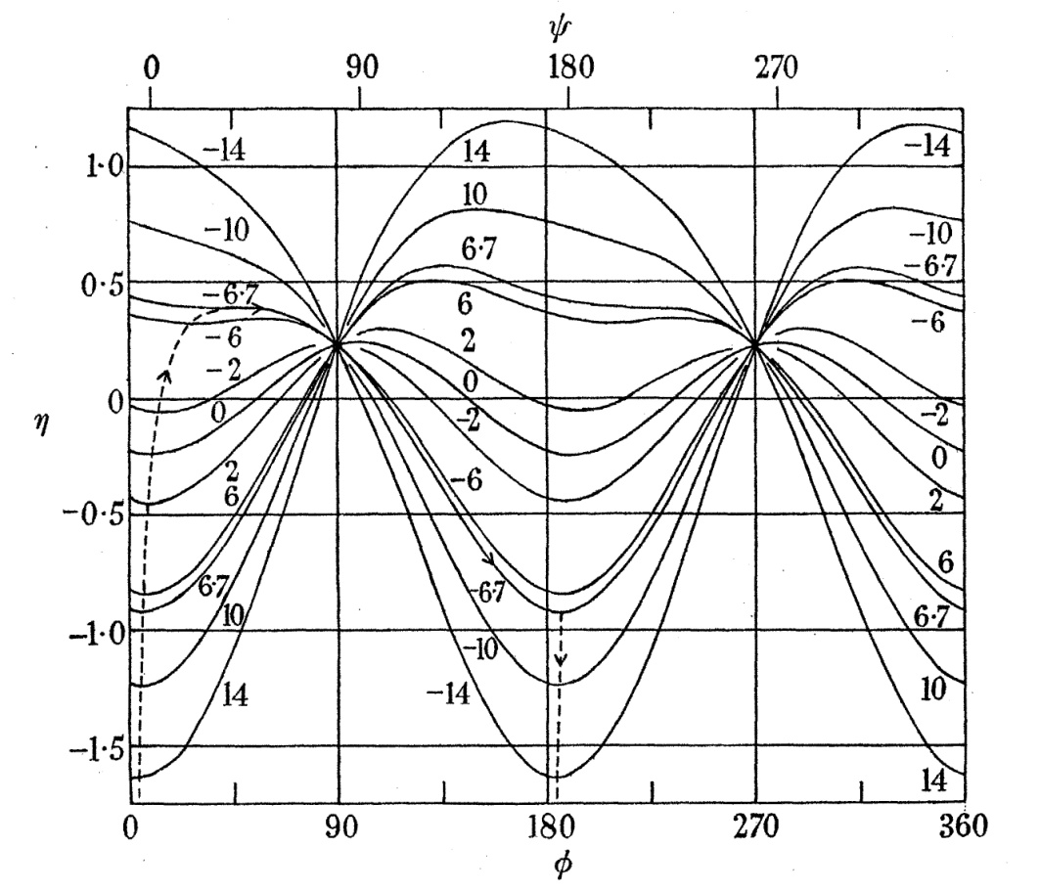
SW Fig. 3
Notes:
values on curves = 10 h

Slide 30
Examples in Maple
(This would be easy to do with Mathematica, also.)
[SW_Lectures_energy_surfaces.mw]

Slide 31

Calculating the Hysteresis Loop

Slide 32
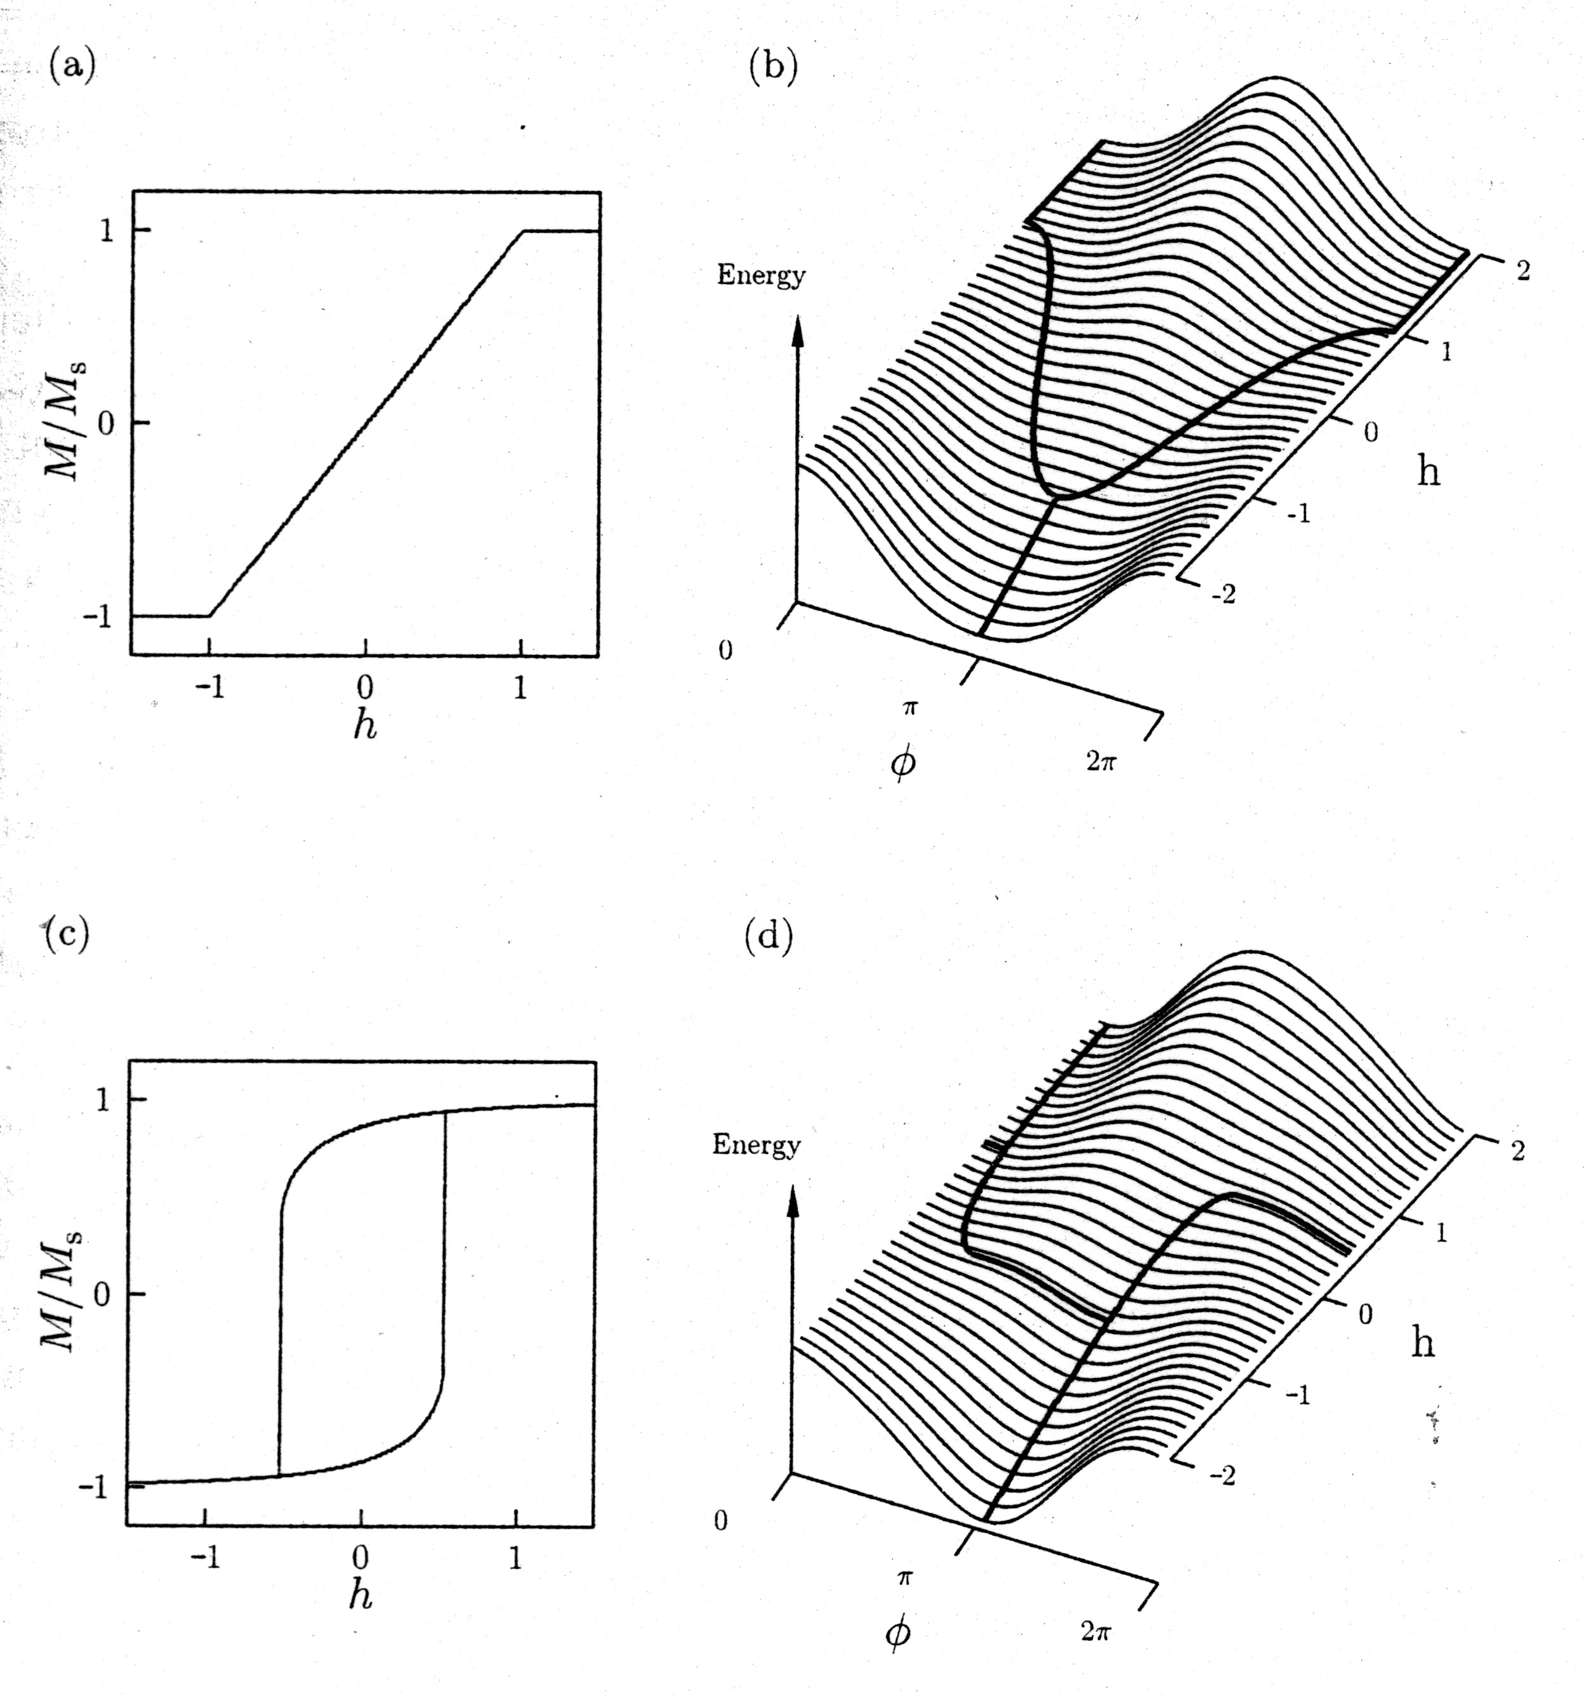
from Blundell

Slide 33
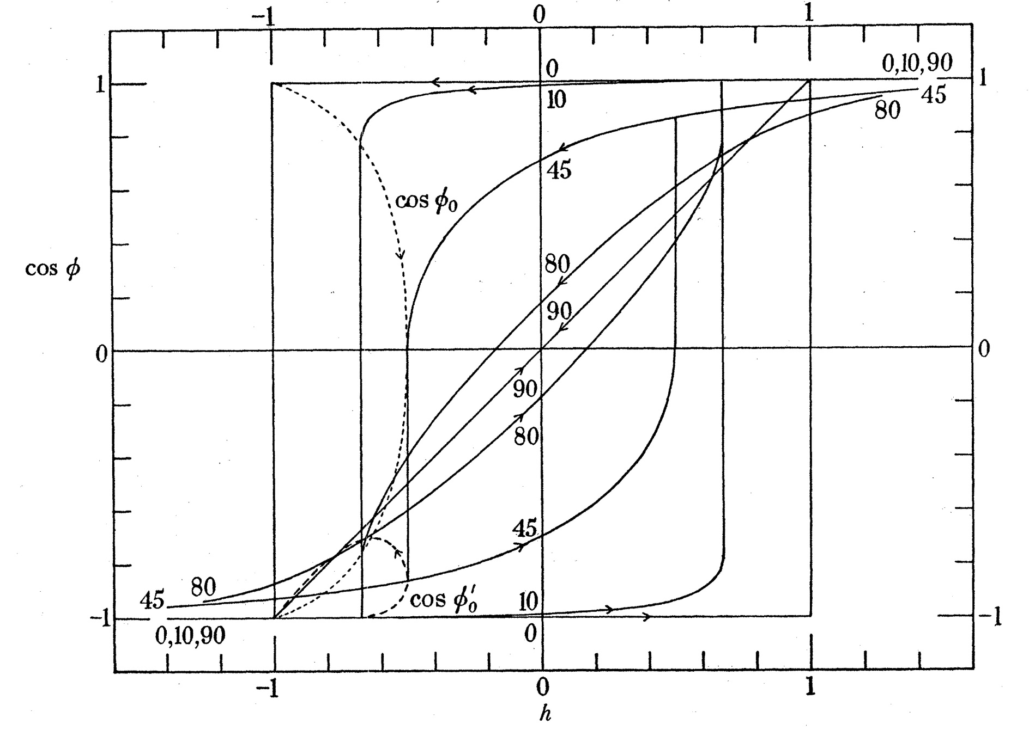
SW Fig. 6
Notes:
angle θ between polar angle and field direction indicated on the curves
dotted curves give M/M_{S} at beginning and end of discontinuous change

Slide 34
Examples in Maple
[SW_Lectures_hysteresis.mw]

Slide 35
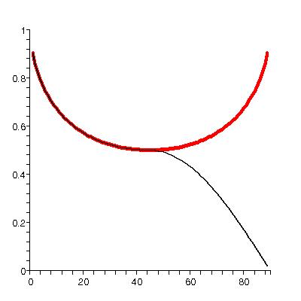
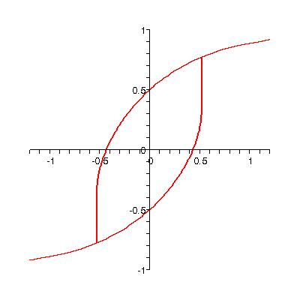
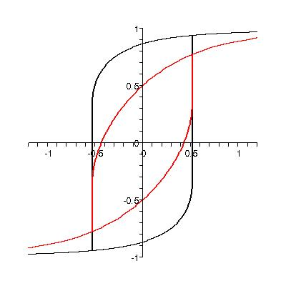
H_{sw} and H_{c}

Slide 36
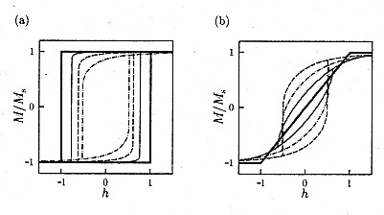
Hysteresis Loops: 0-45º and 45-90º
– symmetries
from
Blundell

Slide 37
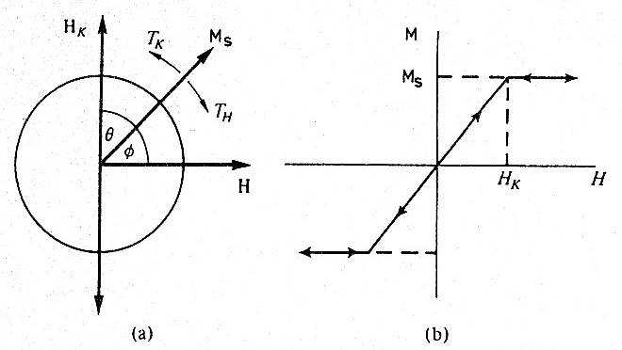
Hysteresis loop for θ = 90º
from
Jiles

Slide 38
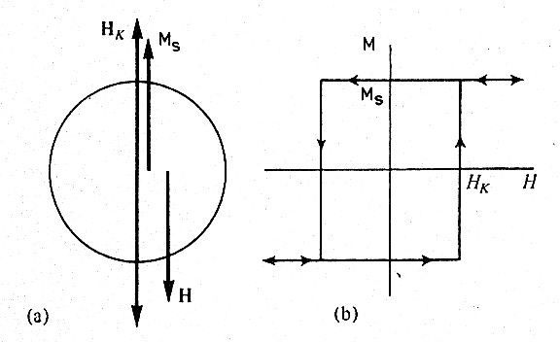
Hysteresis loop for θ = 0º
from
Jiles

Slide 39
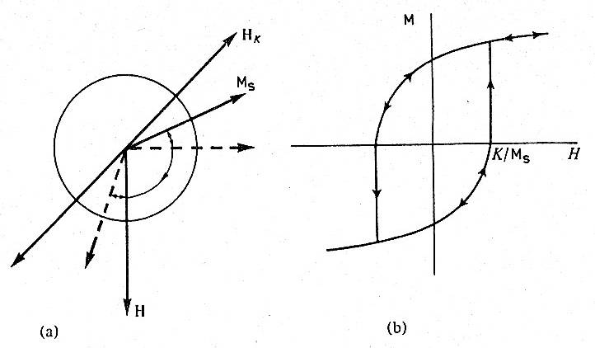
Hysteresis loop for θ = 45º
from
Jiles

Slide 40

Average over Orientations

Slide 41
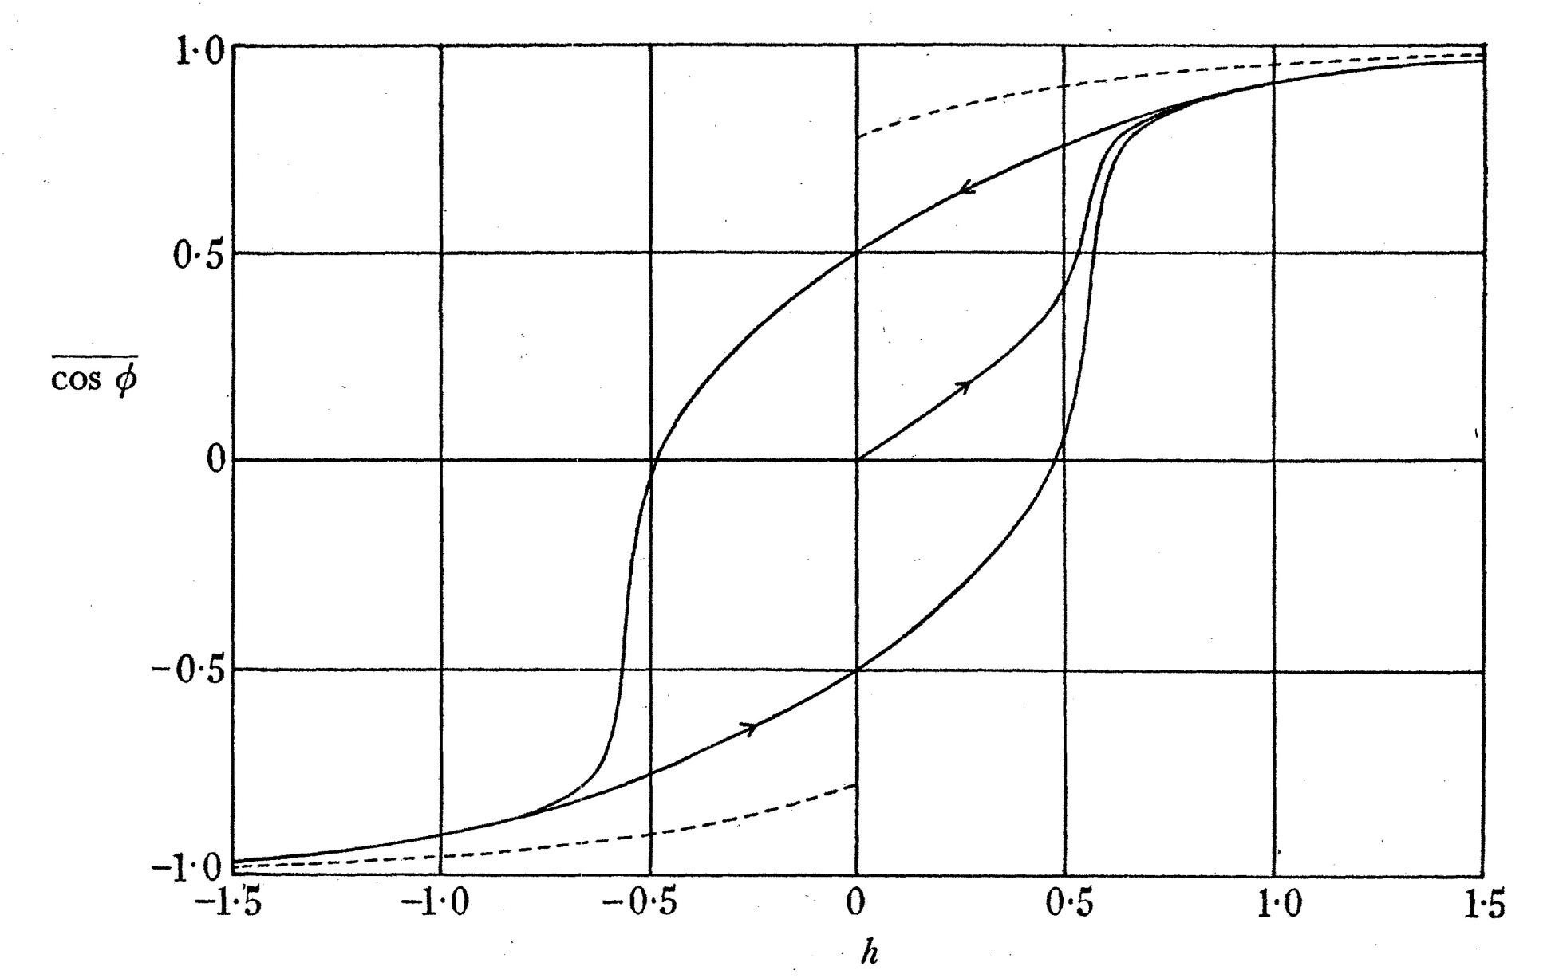
SW Fig. 7

Slide 42
Part 2
Conditions for large coercivity
Applied field
Various forms of magnetic anisotropy
Conditions for single-domain ellipsoidal particles

Slide 43
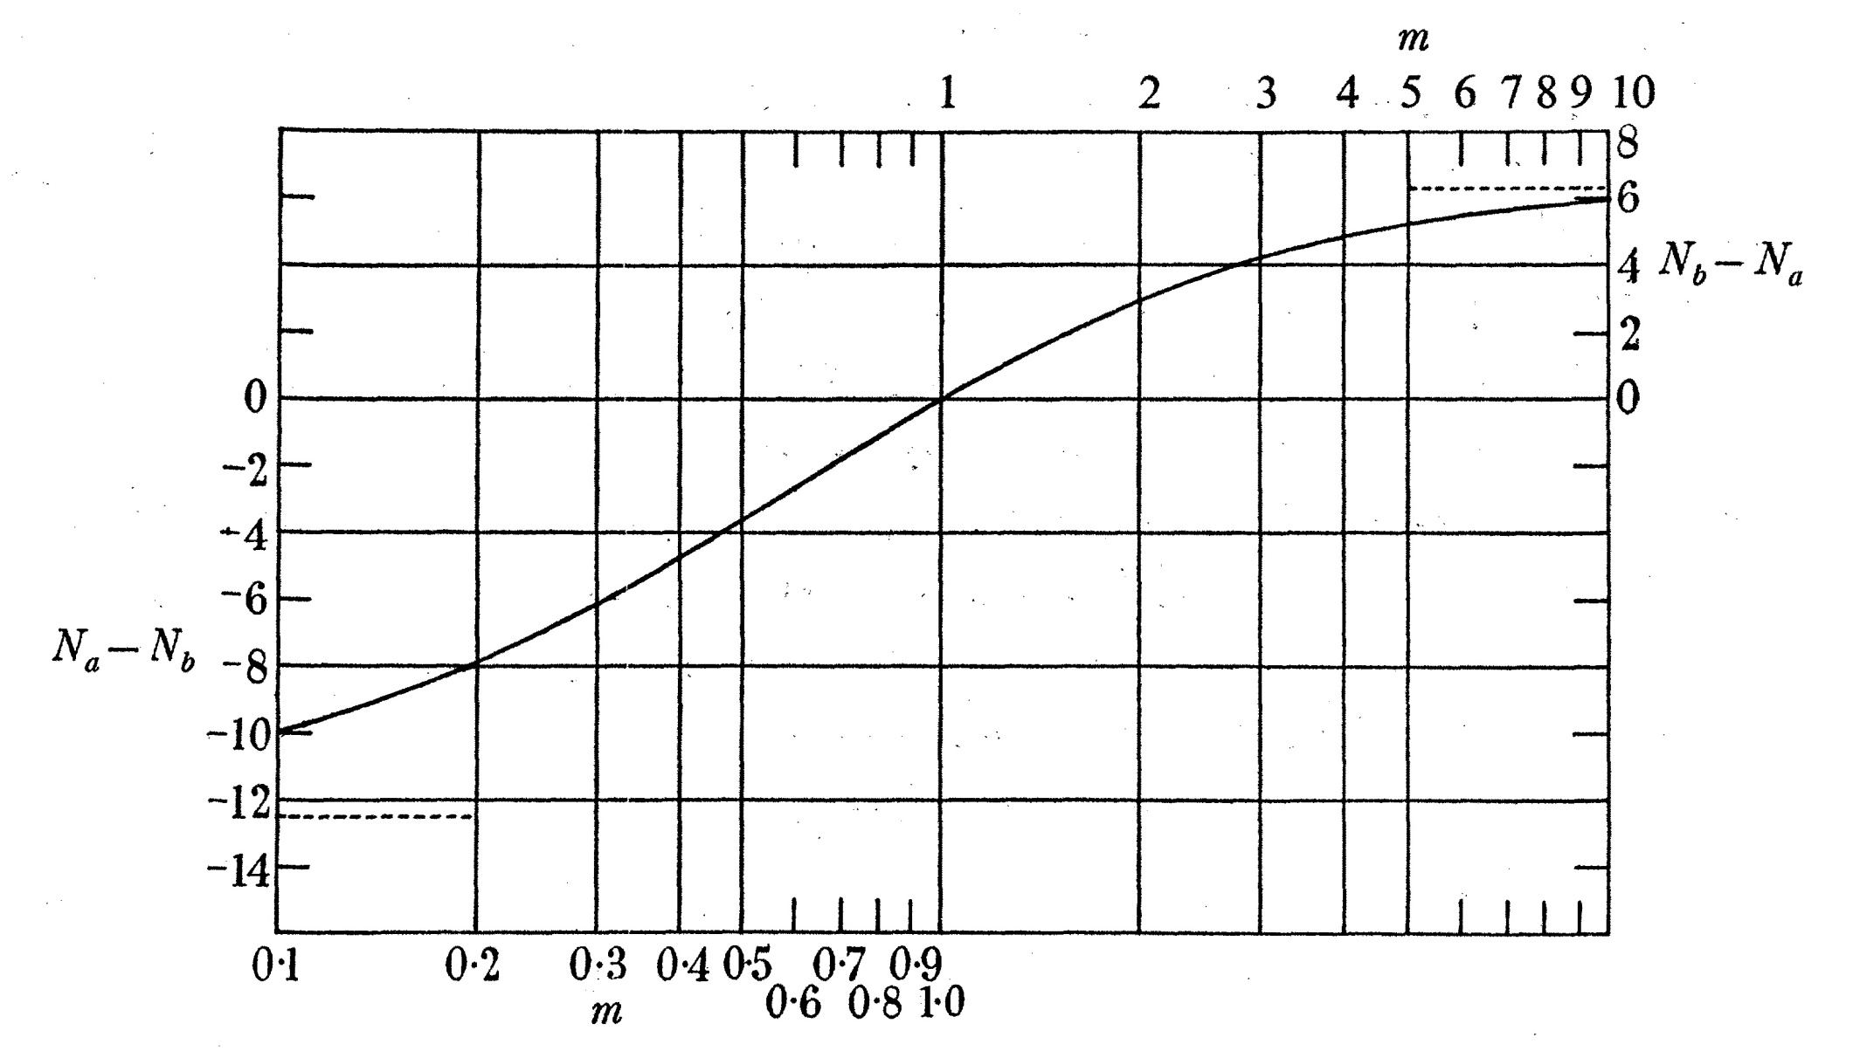
Demagnetization Coefficients: large H_{c} possible
SW Fig. 8
m=a/b
I₀~10³

Slide 44

Applied Field, H
Important! This is the total field experienced by an individual particle.
It must include the field due to the magnetizations of all the other particles around the one we calculate!

Slide 45
Magnetic Anisotropy
Regardless of the origin of the anisotropy energy, the basic physics is approximately the same as we have calculated for prolate spheroids.
This is explicitly true for
Shape anisotropy
Magnetocrystalline anisotropy (uniaxial)
Strain anisotropy

Slide 46
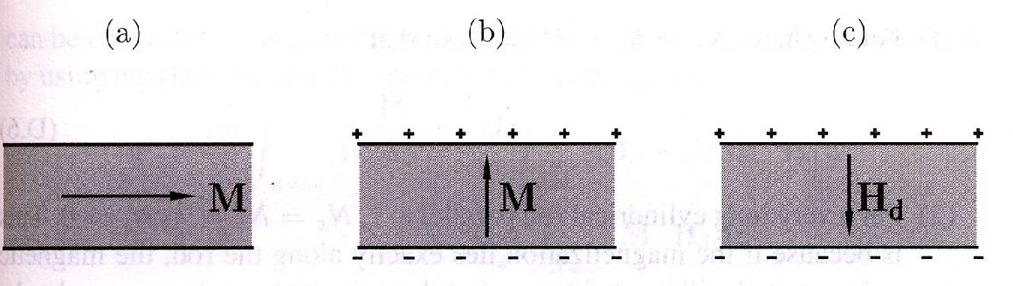
Demagnetizing Field Energy
Energetics of magnetic media are very subtle.
is the “demagnetizing field”
from Blundell

Slide 47
Demagnetizing fields → anisotropy
from Bertotti

Slide 48
How does depend on shape?
is extremely complicated for arbitrarily shaped ferromagnets, but relatively simple for ellipsoidal ones.
And in principal axis coordinate system for the ellipsoid,

Slide 49
Ellipsoids
(Gaussian units)
(SI units)

Slide 50
Examples
Sphere
Long cylindrical rod
Flat plate

Slide 51
Ferromagnet of Arbitrary Shape

Slide 52

Ellipsoids (again)
General
Prolate spheroid

Slide 53
Magnetocrystalline Anisotropy
Uniaxial case is approximately the same mathematics as prolate spheroid. E.g. hexagonal cobalt:
For spherical, single domain particles of Co with easy axes oriented at random, coercivities ~2900 Oe. are possible.

Slide 54
Strain Anisotropy
Uniaxial strain – again, approximately the same mathematics as prolate spheroid. E.g. magnetostriction coefficient λ, uniform tension σ:

Slide 55
Magnitudes of Anisotropies
Prolate spheroids of Fe (m = a/b)
shape > mc for m > 1.05
shape > σ for m > 1.08
Prolate spheroids of Ni
shape > mc for m > 1.09
σ > shape for all m (large λ, small I₀)
Prolate spheroids of Co
shape > mc for m > 3
shape > σ for m > 1.08

Slide 56
Conditions for Single Domain Ellipsoidal Particles
Number of atoms must be
large enough for ferromagnetic order within the particle
small enough so that domain boundary formation is not energetically possible

Slide 57
Domain Walls (Bloch walls)
Energies
Exchange energy: costs energy to rotate neighboring spins
Rotation of N spins through total angle π, so , requires energy per unit area
Anisotropy energy

Slide 58
Domain Walls (2)
Anisotropy energy:
magnetocrystalline
easy axis vs. hard axis
(from spin-orbit interaction and partial quenching of angular momentum)
shape
demagnetizing energy
It costs energy to rotate out of the easy
direction: say,

Slide 59
Domain Walls (3)
Anisotropy energy
Taking for example,
Then we minimize energy to find

Slide 60
Conditions for Single Domain Ellipsoidal Particles (2)
Demagnetizing field energy
Uniform magnetization if E_{D} < E_{wall}
Fe: 10⁵ – 10⁶ atoms
Ni: 10⁷ – 10¹¹ atoms

Slide 61
Thanks
Friends at Uni-Konstanz, where this work was first carried out – some of this group are now at TU-Chemnitz
Prof. Manfred Albrecht for invitation, hospitality and support

