Slide 1
History of the Stern-Gerlach Effect and the Continuing Controversy Surrounding SGE of Free Electrons
William Evenson
Professor of Physics, emeritus
Utah Valley University / Brigham Young University

Slide 2
Outline
History of SGE / Motivation
Interpretations / Significance
Free Electron SGE?
Conclusions - Where Do We Stand Now?

Slide 3
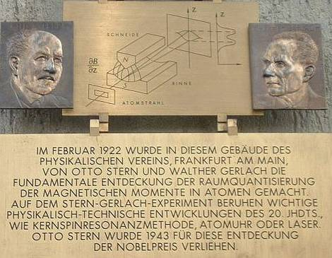

Slide 4
Stern’s Proposal for Experiment
1921 [ZfP 7:249-253(1921)]
Test Bohr/Sommerfeld “old” quantum theory
  assumed quantization of orbital plane orientations
  i.e. directional or space quantization
Proposed to observe the deflection of a beam of atoms in an inhomogeneous magnetic field

Slide 5
Stern’s 1921 Proposal (2)
Zero magnetic field result would be one central trace on collection plate
Turn on inhomogeneous magnetic field
  Classical theory implies maximum intensity at beam center
  Old quantum theory implies splitting into two traces with minimum at beam center; each trace with ½ intensity

Slide 6
Stern’s 1921 Proposal (3)
Putting in reasonable experimental numbers, Stern calculated that he could achieve an observable separation of the two predicted traces for a beam of atoms, ~ 0.01 mm
[Actual experiment produced trace separation of ~ 0.2 mm due to larger field gradient]

Slide 7
The Experiment
Beam of silver atoms
W. Gerlach and O. Stern, ZfP 8:110-111 (1921)
  report of method and measurement of magnetic moment of silver atom, but no clear results yet on directional quantization

Slide 8
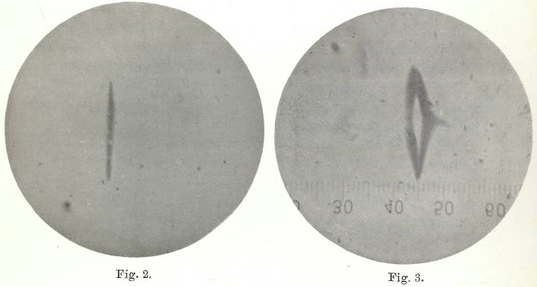
The Experiment (2)
W. Gerlach and O. Stern, ZfP 9:349-352 (1922)

Slide 9
The Experiment (3)
W. Gerlach and O. Stern, ZfP 9:353-355 (1922)
  quantitative analysis of field gradient, splittings, and experimental uncertainties; measurement of µ_{B}
W. Gerlach and O. Stern, Annalen der Physik 74:673-699 (1924)
  directional (space) quantization; thorough description and analysis of SGE

Slide 10
The Experiment (4)
W. Gerlach, Annalen der Physik 76:163-197 (1925)
  extension to Cu and Au

Slide 11
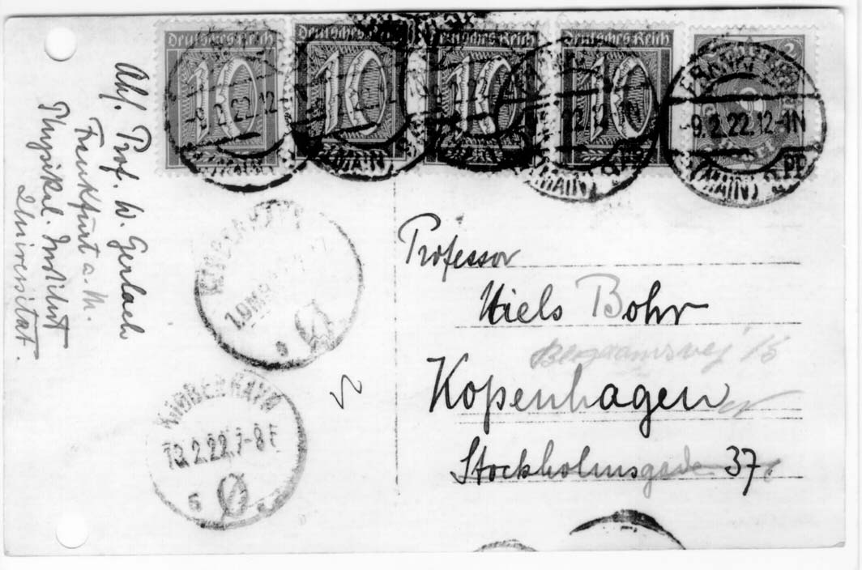
Bohr was a “true believer” and advocate for
Sommerfeld-Debye directional quantization

Slide 12
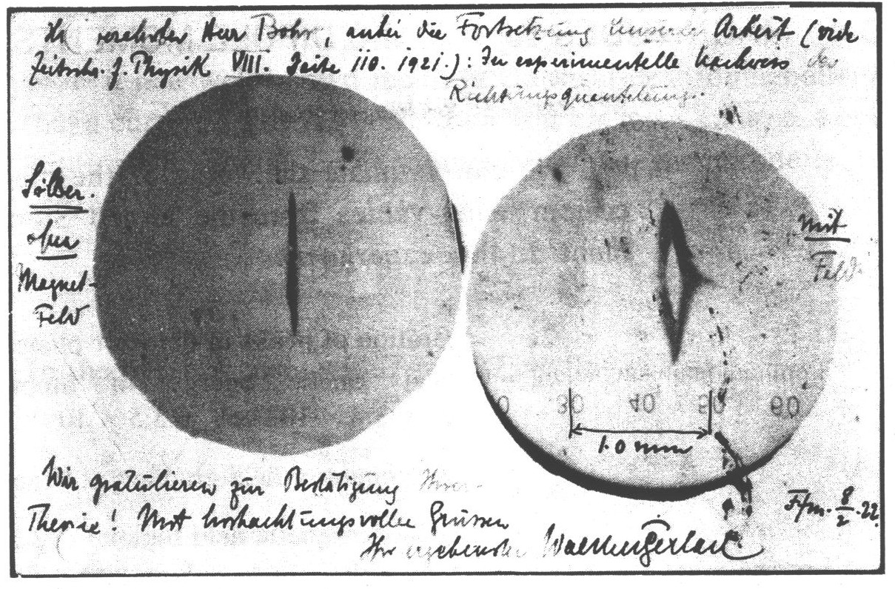
We congratulate you for the confirmation of your theory!

Slide 13
Context
Directional (space) quantization had been proposed by Sommerfeld and Debye with Bohr’s concurrence
Quantum mechanics not yet invented
Spin not yet discovered
Classical-quantum transition apparent by a classically described, randomly oriented atom beam → directional quantization

Slide 14
Context (2)
Entanglement not yet understood or proposed
Quantum measurement issues not yet identified

Slide 15
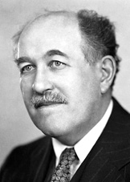
Context (3)
“Beginning” of molecular beam technology
  Note: Stern alone received the Nobel Prize in 1943 "for his contribution to the development of the molecular ray method and his discovery of the magnetic moment of the proton".

Slide 16
Prior Expectations for Expt
The purpose of the experiment as proposed by Stern was to test the Bohr-Sommerfeld-Debye theory (old quantum theory) of magnetism and Zeeman effect assumption of discrete orientations for orbital planes
Stern predicted two traces, not one or three – if Sommerfeld was correct

Slide 17
Prior Expectations for Expt (2)
Stern hoped to examine how atoms could align their angular momenta when brought into a magnetic field
New views since 1913 Üetli Pledge (Schwur): Otto Stern and Max von Laue
“If that crazy model of Bohr turned out to be right, then they would leave physics.” (A. Pais, Inward Bound, p. 208)

Slide 18
Early Response
Einstein and Ehrenfest, ZfP 11:31-34 (1922)
  Thorough analysis of the strange questions raised by SGE
  Raised the question of entanglement by implication: the mystery of the selection of the quantization axis by the direction of the magnetic field which also determined the deflection direction
  [Note: entanglement only introduced in 1935 (Schrödinger)]

Slide 19
Serendipitous Science:
Fun Stories
Warm bed
Cigar smoke
Born's funding assistance
Railroad strike
  [Friedrich & Herschbach, Phys. Today, Dec. 2003, pp. 53-59]

Slide 20
What About Free Electron SGE?
Léon Brillouin proposed in 1927 a longitudinal SGE to measure the magnetic moment of the free electron [CRASP 184:82-84 (1927)]
Revised, more sophisticated proposal in 1928 [PNAS 14:755-763 (1928)]

Slide 21
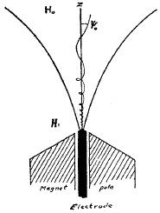
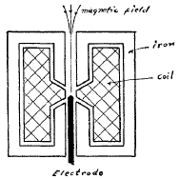
Brillouin’s Longitudinal SGE

Slide 22
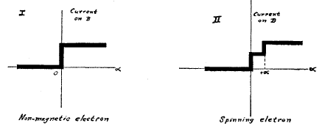
Brillouin’s Longitudinal SGE (2)
(α = insertion angle)

Slide 23
Bohr & Pauli Responses
Not possible, due to Uncertainty Principle!
  N. F. Mott, Proc. Roy. Soc. Lond. A 124:425-442 (1929) – reporting Bohr’s argument
  Pauli in 6th Solvay Conference, 1930
  Pauli in “Die allgemeinen Prinzipien der Wellenmechanik,” Handbuch der Physik (1933)

Slide 24
Bohr, as reported by Mott
“A magnetic moment eh/mc can never be observed directly, e.g., with a magnetometer; there is always an uncertainty in the external electro-magnetic field, due to the uncertainty in the position and velocity of the electron, and this uncertainty is greater than the effect of the electron magnet we are trying to observe.”

Slide 25
Bohr, as reported by Mott (2)
“Our only hope of observing the moment of a free electron is to obtain a ‘polarised’ beam, in which all the spin axes are pointing along the same direction, or at any rate more in one direction than another. The obvious method of obtaining such a polarised beam is a Stern- Gerlach experiment, but here again the Uncertainty Principle shows that this is impossible;”

Slide 26
Bohr, as reported by Mott (3)
“in fact, it appears certain that no experiment based on the classical idea of an electron magnet can ever detect the magnetic moment of the electron.”
See also Mott & Massey, The Theory of Atomic Collisions

Slide 27
Bohr and Pauli Main Points
Uncertainty Principle
“It is impossible to observe the spin of an electron, separated fully from its orbital momentum, by means of experiments based on the concept of classical particle trajectories.”

Slide 28
Bohr and Pauli Main Points (2)
Pauli (1930):
“One can show, in fact, that due to the size of the magnetic moment of the electron, the conditions necessary so that the actions taken on the intrinsic moment of a free electron will not be masked by the Lorentz force are precisely favorable to the appearance of diffraction effects that prevent observation of these actions.”

Slide 29
Enter Dehmelt
“Continuous SGE”
Hans Dehmelt, PNAS 83:2291-2294 (1986)
Nondestructive experiment
Inhomogeneous magnetic field provided by weak auxiliary magnetic bottle
Observed by change of frequency in storage cell

Slide 30
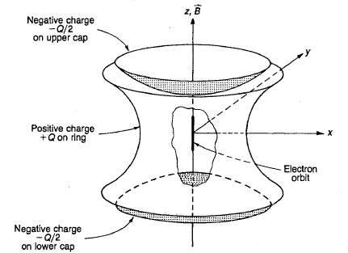
Geonium atom – monoelectron mode

Slide 31
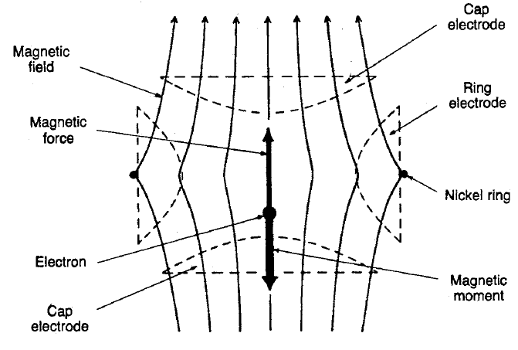
CSGE – Schematic

Slide 32
CSGE
Longitudinal, like Brillouin proposal
New detection scheme – frequency instead of observing changes in classical particle trajectories
Greatly increased detection sensitivity
Essentially free individual electron whose spin relaxation time is practically infinite

Slide 33
CSGE (2)
Measurement may be repeated on the same particle as often as one likes or even continuously
Classical SGE is termed “Transient SGE”, i.e. TSGE
CSGE determines spin direction and reduces wavefunction as in a msrmt
CSGE has produced precise exptl value for µ_{B}

Slide 34
Dehmelt’s argument vs. Pauli
Pauli’s “theorem” quoted and published even very recently
  “It is impossible to observe the spin of an electron, separated fully from its orbital momentum, by means of experiments based on the concept of classical particle trajectories.”

Slide 35
Dehmelt’s argument vs. Pauli (2)
“Actually, Pauli had merely shown . . . that incremental magnetic deflection due to spin appears only as a perturbation ~ħ of the classical trajectory of the spin-less point electron, similar to the wave mechanical blurring of the trajectory, which is also ~ħ^{½}.

Slide 36
Dehmelt’s argument vs. Pauli (3)
“Obviously, when making the blurring vanish in the classical limit by letting ħ → 0, Stern-Gerlach deflection vanishes too, seemingly proving Pauli’s point. However, in reality ħ is an invariable empirical constant >0, and the classical limit must be approached in other ways.

Slide 37
Dehmelt’s argument vs. Pauli (4)
“For example, one can
  (a) pick an experiment with zero magnetic deflection of a spin-less electron, and simultaneously
  (b) make the forces on the spin very large by employing a very inhomogeneous magnetic field B, and further
  (c) make diffraction and other wave effects completely unimportant by using apparatus much larger than the electron wave packet.

Slide 38
Dehmelt’s argument vs. Pauli (5)
“This plan then creates a domain of spin dominated near-classical trajectories contrary to Pauli. . . .”

Slide 39
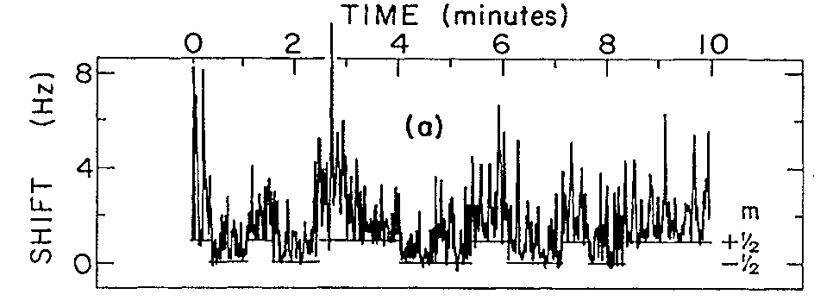
CSGE Results

Slide 40
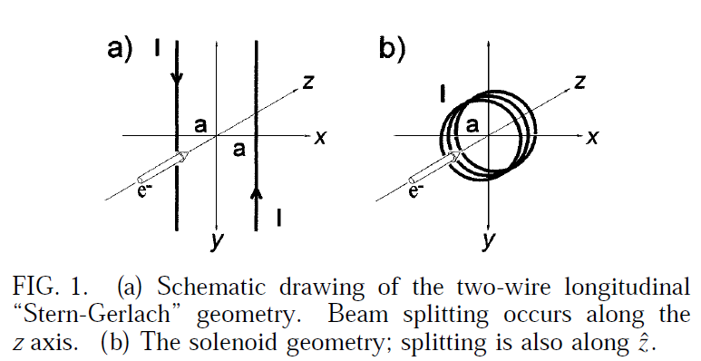
Stern-Gerlach Effect for Electron Beams
Batelaan, Gay, and Schwendiman, PRL 79:4517-4521 (1997)

Slide 41
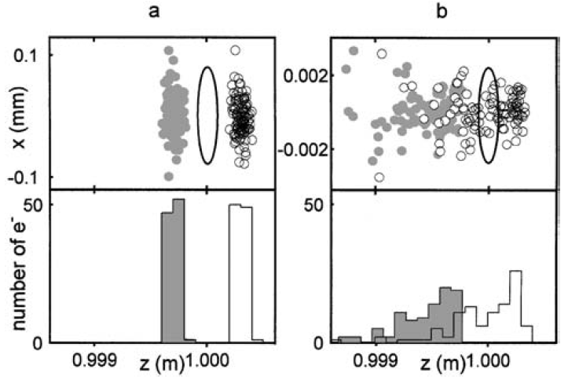
Batelaan Simulation

Slide 42
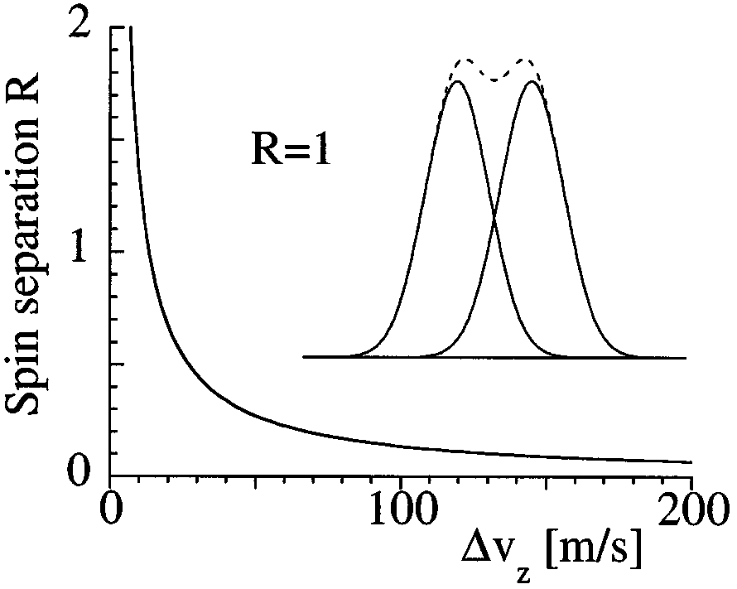
Criticism: Rutherford & Grobe
Δv_{z} =
initial
velocity
width

Slide 43
Conclusions: Where Are We?
SGE is a classic experiment of quantum physics
Its interpretation has changed with the development of physics
  discovery of spin
  invention of QM
  understanding of entanglement and quantum measurement issues

Slide 44
Conclusions (2)
Possibility of free electron SGE was denied by Bohr and Pauli by 1928
Bohr/Pauli arguments were codified into textbooks and monographs – widely accepted up until today
Any attempt to turn Brillouin’s idea or any modifications of it into a real experiment was suppressed early on by the disapproval of these leading figures

Slide 45
Conclusions (3)
Dehmelt’s CSGE led to reassessment of Bohr/Pauli arguments and new proposals for free electron SGE
Successful free electron experiments have not yet been carried out beyond the Dehmelt trapped electron scenario, but it appears that the objections in principle have been overcome while the practical difficulties remain formidable

Slide 46
Thanks
Prof. J-F Van Huele, Brigham Young University, for helpful discussions and ideas
Prof. Manfred Albrecht for the invitation, motivation to complete this project, and excellent hospitality during this visit

