Slide 1
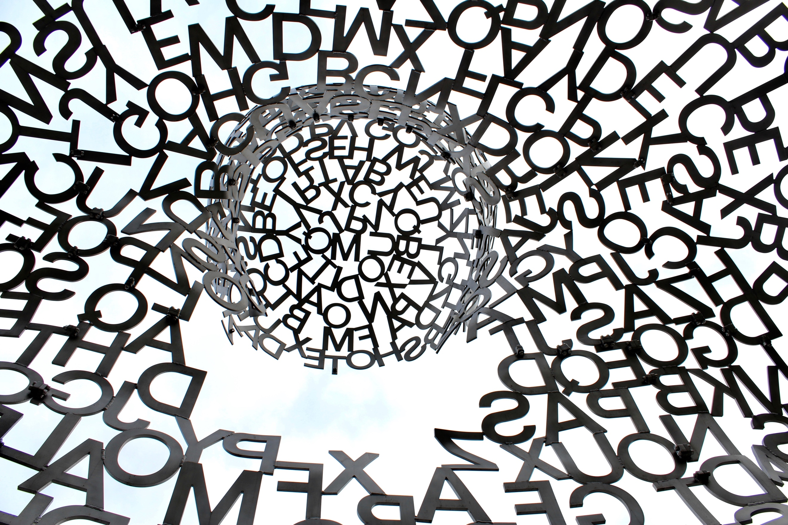
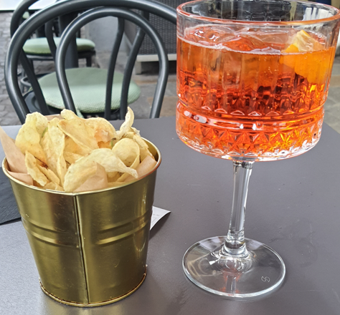
IAWE 25
Stony Brook University
Empirical perception studies on Italian English: Neglected, charming or unaccepted?
Notes:
1

Slide 2
introduction | research: ItE | attitudes to features | learning & attitudes to text | conclusions
2/21
1. Introduction: an agent speaking non-standard Englishes
Research Context: Conversational Pedagogical Agents (CPA) in Hybrid Societies

Slide 3
introduction | research: ItE | attitudes to features | learning & attitudes to text | conclusions
3/21
1. Introduction: an agent speaking non-standard Englishes
Agent Creation: Text-to-Speech (TTS)
Goal: A TTS synthesis system that can synthesize English text in different non-native accents.
In the synthesized speech we want to control the following features:
morphosyntactic cues e.g. syntax, grammar
phonetic cues e.g. pronunciation of phonemes
prosodic cues e.g. stress, intonation
Our TTS system is based on two different models and uses transfer learning.
Example output mel-spectrogram
Difference original and synthesized audio

Slide 4
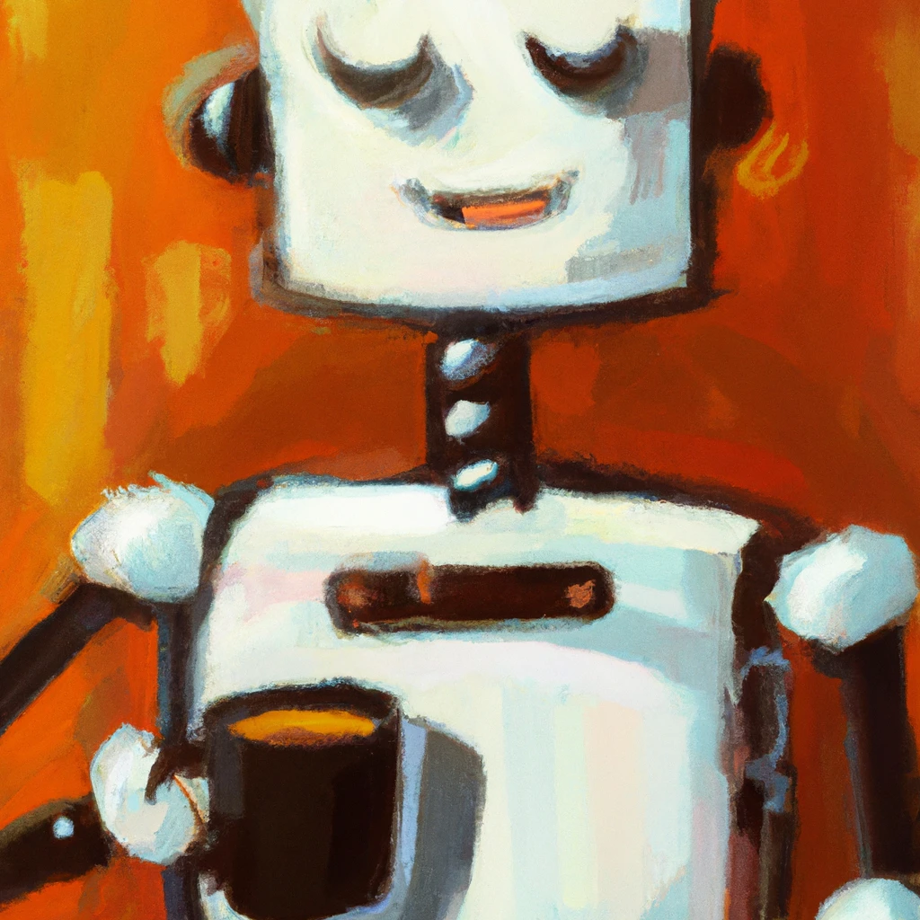
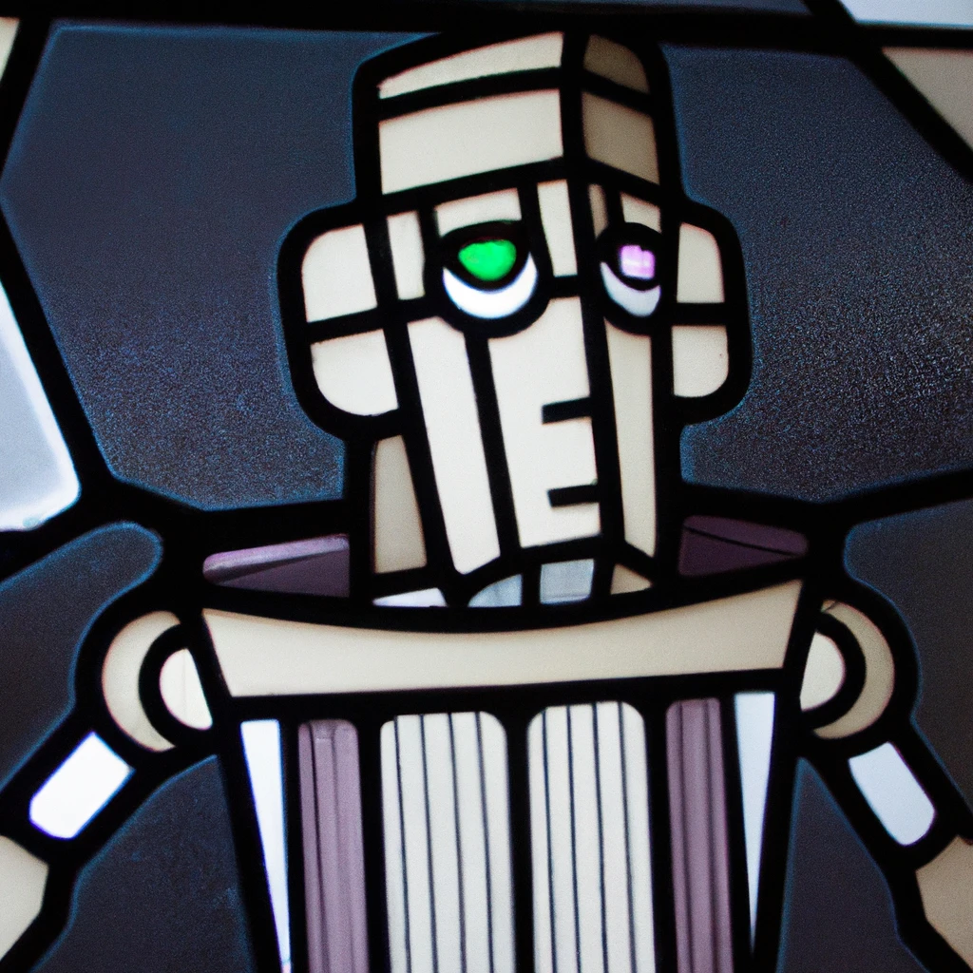
introduction | research: ItE | attitudes to features | learning & attitudes to text | conclusions
4/21
1. Introduction: an agent speaking non-standard Englishes
Aim: Designing a credible pedagogical agent speaking non-native varieties
Issue: 24% significant impact of PAs + 18% improved learning outcomes (Martha & Santoso 2019)
Mirror variety without stereotypes (Labov 1994: 78)?
Non-native PA to improve learning outcomes?
Attributed characteristics?
Warmth, likeableness
Competence, credibility, ease of understanding
DALL-E
Notes:
Intensive work to improve PAs:
Intensive work needed to improve PAs:
12/50 papers with significant impact of PAs
9/50 papers with improved learning outcomes (Martha & Santoso 2019)
How to design a PA that mirrors the user’s language variety but avoids stereotypes (see Labov 1994: 78)?
Does the use of the non-native PA improve learning outcomes?
What characteristics do the users attribute to the PA?
Warmth, likeableness
Competence, credibility, ease of understanding

Slide 5
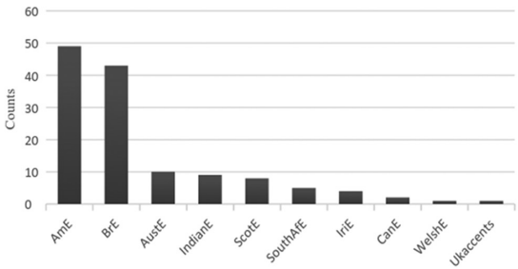
introduction | research: ItE | attitudes to features | learning & attitudes to text | conclusions
5/21
1. Introduction: an agent speaking non-standard Englishes
English varieties in Text-to-Speech (TTS) systems for English-medium instruction in education
TTS in English-medium instruction – efficient, easily adaptable, sustainable
No solutions for expanding-circle varieties (Kachru 1991) like Italian English
Advantages of learning from teachers with a familiar accent
Retention: Austrian German > Standard German (Rey & Steib 2013)
Preferred local dialects for robots: Arabic, Irish, New Zealand English (Andrist et al. 2015, Tamagawa et al., 2011, Sandygulova & O’Hare, 2015)
50 TTS systems with mostly inner circle varieties (Karakaş 2017: 113)

Slide 6
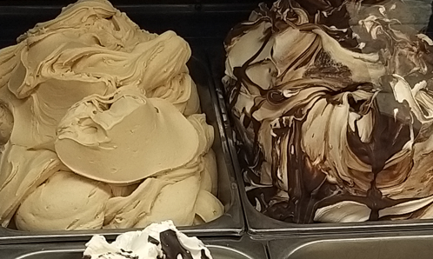
introduction | research: ItE | methodologies | analyses | conclusions
6/21
2. Research on Italian English: neglected Expanding Circle
English has no official status in Italy
and little research
focus on English-Italian contacts/loanwords and attitudes from unification in 1861 through Fascism to European Union influences
Pulcini (1994: 50): “the growing phenomenon of ‘nativization’ of English in Europe” “attitudes range from a mild criticism to a total acceptance of the presence of English in many fields of knowledge and social life”
Pulcini (1997): “the wide use of dialects has necessitated a much greater emphasis on the teaching of the national language rather than of foreign languages” (82) “recently it has become part of the curriculum for non-specialists who need to acquire proficiency in English for special academic purposes, e.g., in the faculties of Medicine, Engineering, Law, Economics, Mathematics, Political Sciences, and Arts (Italian, History, Philosophy, Communication Sciences)” (82f)
Italian has a strong regional variation, dialects from N to S, pronunciation differences in Italian dialects are well-known to students
Italian politicians at European level in interviews speak for or less Italian E:
BBC 2016 Matteo Renzi prova il suo inglese a Harvard: https://www.youtube.com/watch?v=n2NHWzWxgu4
Giorgia Meloni likens Brothers of Italy party to British Tories: https://www.youtube.com/watch?v=da4OO5mLZv0

Slide 7
introduction | research: ItE | attitudes to features | learning & attitudes to text | conclusions
7/21
2. Research on Italian English: 15 linguistic variables
feature
3rd p -s, ʌ > o
final –t > ɪd
voicing s > z
0 article
double consonant p
h dropping/insertion
u > ü
inserted prep
ð > z
rolling r
weak > strong ending
i: > ɪ
final vowel
double consonant m
2x final vowel, ɪ > i:, double consonant tT, sS
Everybody love Italy, but not Brexit.
The Brexit decision was too rushɪd.
It should have been done more Zlowly.
British people made __ bad decision on EU.
I am not hapPy about it.
But now the istory of Brexit is over, Britain is hout of the EU.
It is tü late to reverse this decision now.
We cannot continue discuss about this problem.
In diz moment, we cannot do anything any more.
The Rest of Europe has many other problems.
We must come to a final decisiOn.
We have to start a new shɪt of paper in our history.
Now we must fly the new European flagE.
I hope we can all enjoy the sumMer.
I cannotE expresSE IItaly betTer.

Slide 8
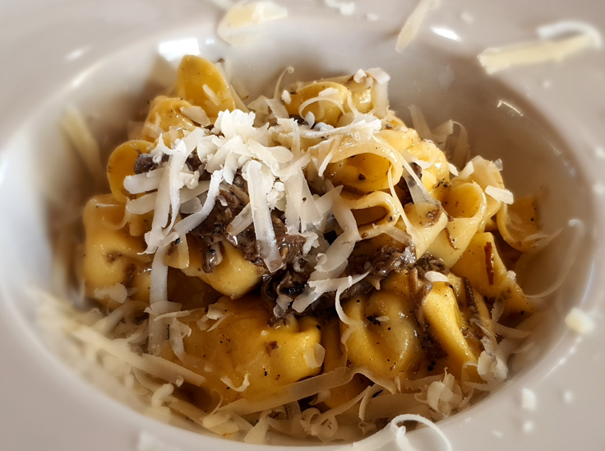
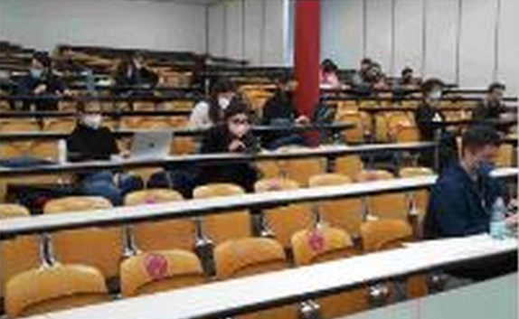
introduction | research: ItE | attitudes to features | learning & attitudes to text | conclusions
8/21
3. Attitudes to individual features of Italian English
Pilot study: 25 students of engineering in Pavia during regular class

Slide 9
introduction | research: ItE | attitudes to features | learning & attitudes to text | conclusions
9/21
3. Attitudes to individual features of Italian English
Patterns:
all even numbers (1,3,5, etc.) are rated less favourably are generated as “computer voice”, all even numbers are generated as “human”
the famous h dropping and insertion (6) goes surprisingly unnoticed and scores highest for competence (credible), less for appealing (warmth)
the massive stereotypical final vowels (“sounds like Mafia”) in the last example (15) received the lowest points
Stimulus | Feature
1 | 3rd p -s, ʌ > o
2 | final –t > ɪd
3 | voicing s > z
4 | 0 article
5 | double consonant p
6 | h dropping/insertion
7 | u > ü
8 | inserted prep
9 | ð > z
10 | rolling r
11 | weak > strong ending
12 | i: > ɪ
13 | final vowel
14 | double consonant m
15 | 3x final vowel, ɪ > i:

Slide 10
introduction | research: ItE | attitudes to features | learning & attitudes to text | conclusions
10/21
3. Attitudes to individual features of Italian English
Rating of features in trivia statements (based on Boduch-Grabka & Lev-Ari 2021) “trivia statements produced by speakers of non-native varieties are less trusted than those produced by speakers of native varieties”
Statement | Truth value | ItE feature
The cigarette lighter was invented before matches. | TRUE | Geminate /t/ -> /t:ə/
Everybody tend to blink about 20 times a minute. | FALSE | Everybody + plural
The only animal born with horns is the giraffe. | TRUE | /ə/ after final geminates
There are more than two hundred different breeds of dogs. | TRUE | /u/ -> /ju/
Crocodiles can't stick out their tongues to prevent them from biting off their tongue. | TRUE | /ð/ -> /d/
The lowest place on Earth is Death Valley in North America. | FALSE | Rolling /r/
The longest wedding dress was longer than three football fields. | TRUE | Geminate /d/ -> /d:/
A cat can jump as much as fifteen times its height. | FALSE | /h/ drop
Small crocodilians cannot survive for more than a few days without food. | FALSE | /sm/ -> /zm/
Jerusalem in Israel is the oldest city in the world. | FALSE | /ɪ/ -> /i:/
Sharks mostly prefer women and attack them ten times more often than they attack men. | FALSE | /oʊ/ -> /ɔ/
The average human body contains around twenty pints of blood. | FALSE | /ə/ -> /ɔ/ and shifted stress
About hundred fifteen thousand deaths a year in the US are due to habitual drug use. | FALSE | /i:/ -> /ɪ/
Every third English student wants to become teacher. | TRUE | Determiner: indefinite -> 0
About one third of the food produced worldwide ends up in (the) garbage. | FALSE | Past tense /ɪd/ (spelling)
The European Parliament meets once a month to discuss about environmental issues. | FALSE | discuss about
Carrots were the first vegetable to be grown in space. | FALSE | AmE_1
Falcons are the only birds who can see the color blue. | FALSE | AmE_2
There are approximately 20,000 feathers on an eagle. | TRUE | AmE_3
About 300 grapes go into one bottle of wine. | TRUE | AmE_4
Crocodiles can't stick out their tongues to prevent them from biting off their tongue. | TRUE | CzE: /ŋ/ -> /ŋk/
The lowest place on Earth is Death Valley in North America. | FALSE | CzE: /v/ -> /w/
Jerusalem in Israel is the oldest city in the world. | FALSE | CzE: /ə/ -> /ɛ/ (spelling)

Slide 11
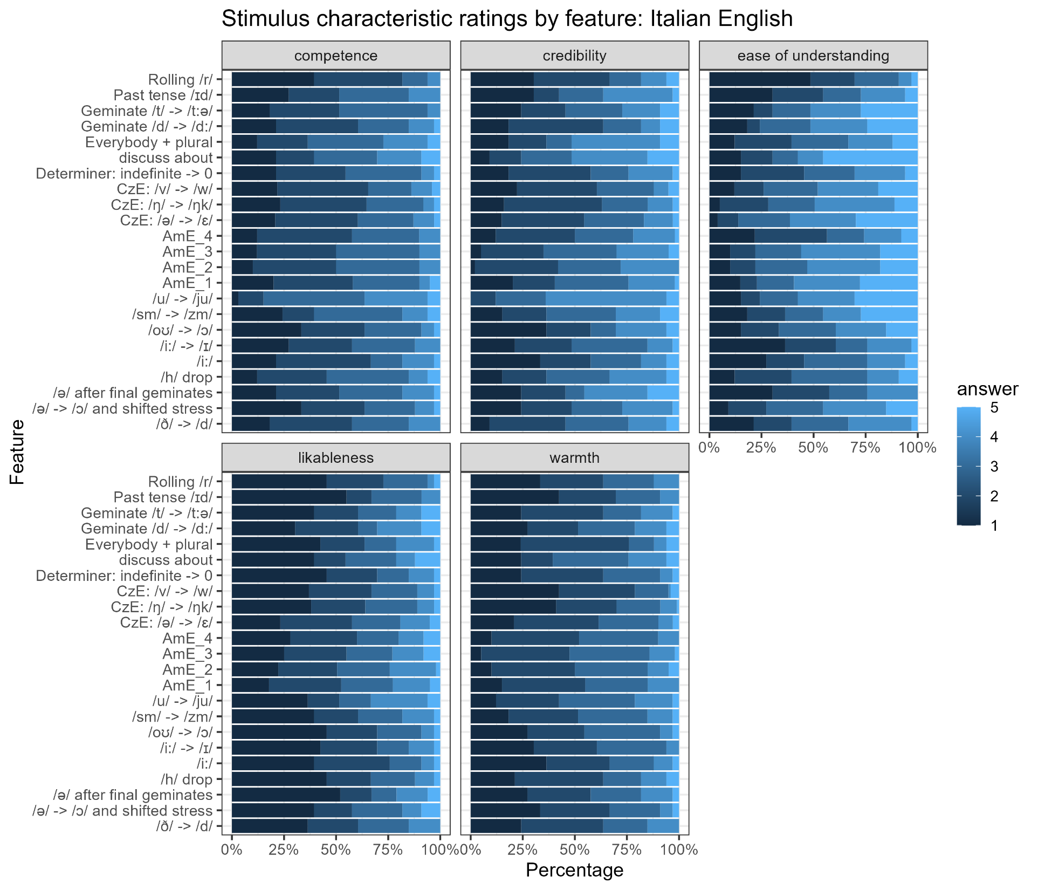
highest
lowest
results cluster round the mean

Slide 12
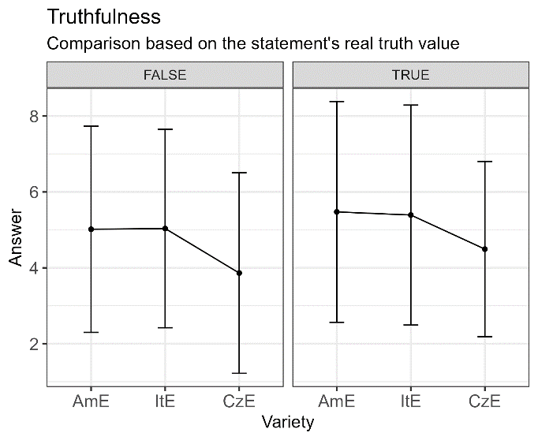
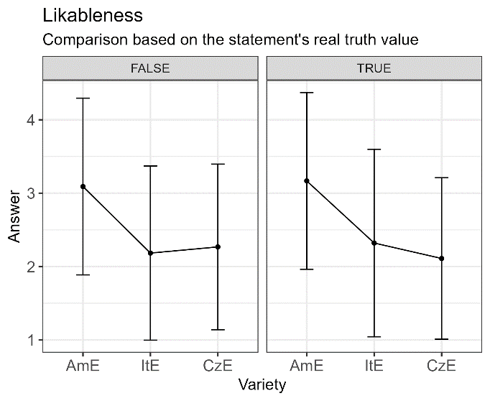
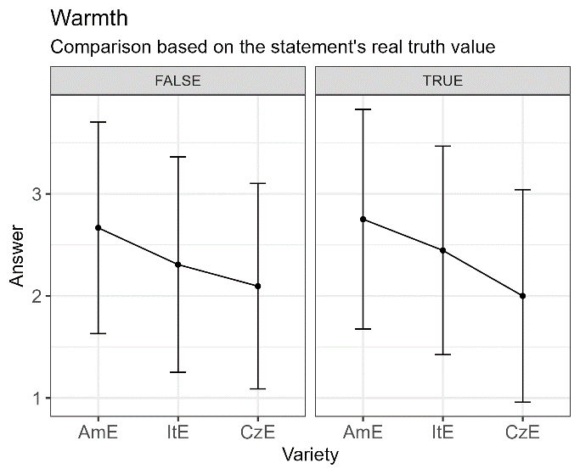
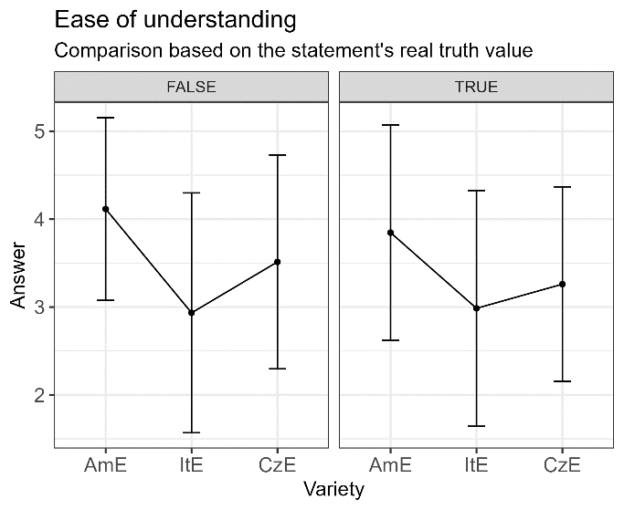
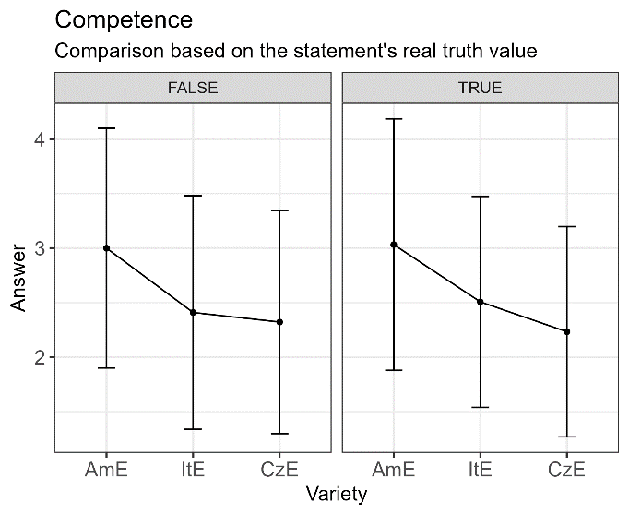
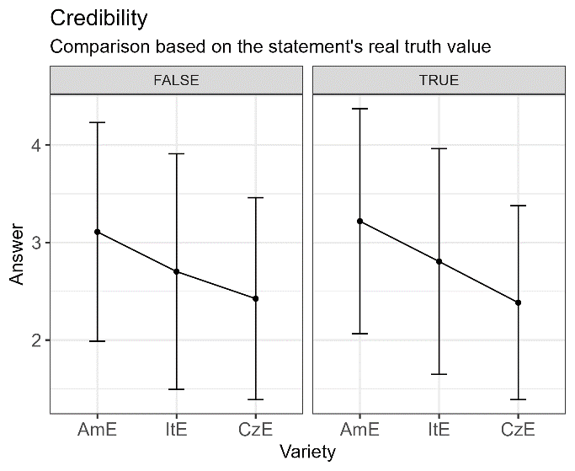
introduction | research: ItE | attitudes to features | learning & attitudes to text | conclusions
12/21
3. Attitudes to individual features of Italian English
Consistent rating of features in trivia statements (based on Boduch-Grabka & Lev-Ari 2021)
ItE ranked systematically lower than AmE
10-point scale!

Slide 13
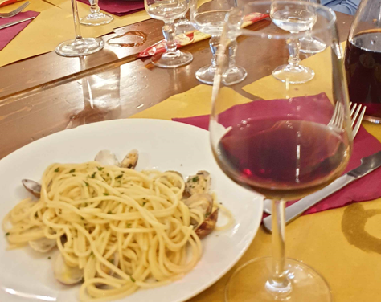
introduction | research: ItE | attitudes to features | learning & attitudes to text | conclusions
13/21
4. Learning and attitudes to complete ItE texts
Excerpt from “Lemons and Watermelons: Visual Advertising and Conceptual Blending” (Delibegović Džanić & Berberović 2021: 124)
2:30 min audio
Short but complex
TTS system with Czech, Italian and American English model
WAVE audio
Denoising
waveglow (Taubert, 2022b)
denoiser (Défossez et al., 2022)
Text synthesis to Mel-spectrogram
tacotron (Taubert, 2022a)

Slide 14
introduction | research: ItE | attitudes to features | learning & attitudes to text | conclusions
14/21
4. Learning and attitudes to complete ItE texts
Modena and Padova (& Brno) Participants
Age: 21-23 (76%) and 24-26 years old (13%)
Gender: 70 females, 19 males
Field: mostly Humanities (80% of the Czech, 85% of the Italian)
Degree: MA + 9 Italian PhDs
First year
Ø15 years studied English
Notes:
Czech: M = 15.45 (SD = 4.94)
Italian: M = 15.13 (SD = 2.85)

Slide 15
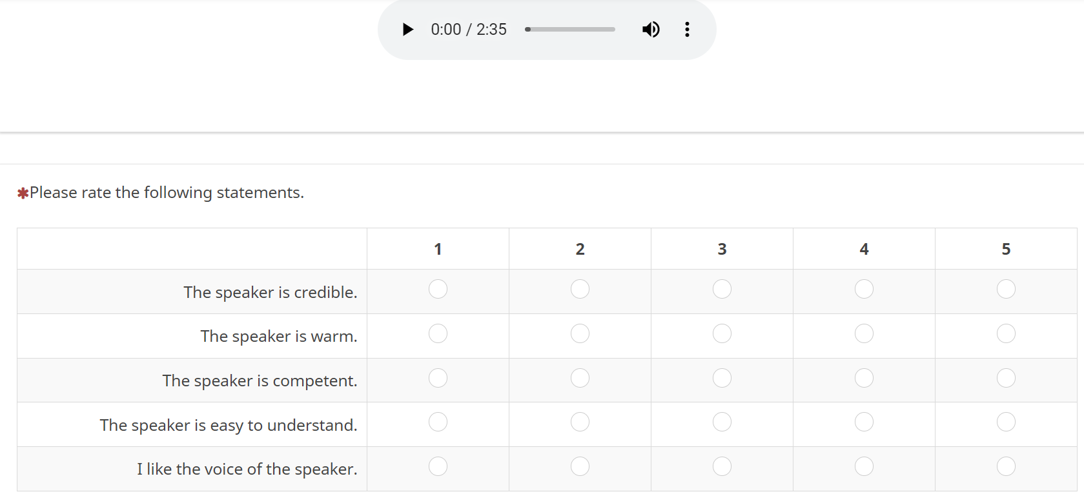
Data collection: online from classroom in Modena
introduction | research: ItE | attitudes to features | learning & attitudes to text | conclusions
15/21
Lecture
Speaker characteristics
Multiple choice
General vocabulary
Academic vocabulary
Open questions
Demographics

Slide 16
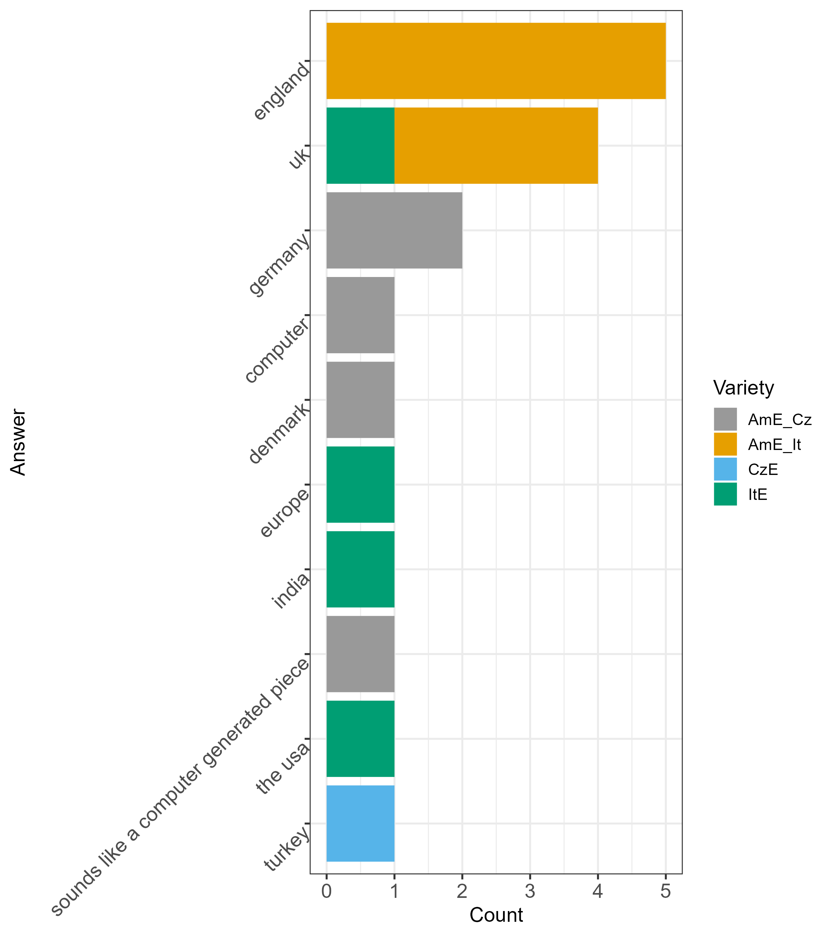
Results: Origin of the PA
introduction | research: ItE | attitudes to features | learning & attitudes to text | conclusions
16/21
Figure: Identification of the speaker’s origin per variety (left) Wrong answers on the speaker’s origin (right).
Note: American English evaluated by Czechs (AmE_Cz) and Italians (AmE_It); Czech English (CzE), Italian English (ItE).
Italians recognise AmE better than Cz, but ItE even better

Slide 17
Results: Voice characteristics
introduction | research: ItE | attitudes to features | learning & attitudes to text | conclusions
17/21
Czechs and Italians have rated the characteristics similarly on average (W = 682, p = .216)
Czech M = 2.81, SD = 0.63
Italian M = 3.07, SD = 0.885
Neutral response bias?
Characteristics rated differently: competence consistently differs from warmth
Characteristic 1 | Characteristic 2 | N 1 | N 2 | W | p | p adjusted | Significance
competence | credibility | 89 | 89 | 3894.5 | .843 | 1 | ns
competence | ease of understanding | 89 | 89 | 3657.5 | .364 | 1 | ns
competence | likableness | 89 | 89 | 5411 | 1.34*10⁻⁵ | 8.04*10⁻⁵ | ***
competence | warmth | 89 | 89 | 5760.5 | 5.64*10⁻⁸ | 5.08*10⁻⁷ | ***
credibility | ease of understanding | 89 | 89 | 3691.5 | .42 | 1 | ns
credibility | likableness | 89 | 89 | 5435.5 | 1*10⁻⁵ | 7*10⁻⁵ | ***
credibility | warmth | 89 | 89 | 5780.5 | 4.21*10⁻⁰⁸ | 4.21*10⁻⁰⁷ | ***
ease of understanding | likableness | 89 | 89 | 5422.5 | 1.37*10⁻⁵ | 8.04*10⁻⁵ | ***
ease of understanding | warmth | 89 | 89 | 5709.5 | 1.77*10⁻⁷ | 1.42*10⁻⁶ | ***
likableness | warmth | 89 | 89 | 4159.5 | .548 | 1 | ns
Table: Results of Wilcoxon signed-rank test comparing characteristic ratings.
(ns = not significant, *** p < .001)

Slide 18
ItE agent is rated as competent but cold
introduction | research: ItE | attitudes to features | learning & attitudes to text | conclusions
18/21
Figure: PA varieties and their rated voice characteristics. Means with error bars representing standard errors.
ItE ranked systematically lower than AmE

Slide 19
Results: Voice characteristics Italians consistently prefer American English
introduction | research: ItE | attitudes to features | learning & attitudes to text | conclusions
19/21
Figure: Voice characteristics rated by variety of PA. Means with error bars representing standard errors.
ItE ranked systematically lower than AmE

Slide 20
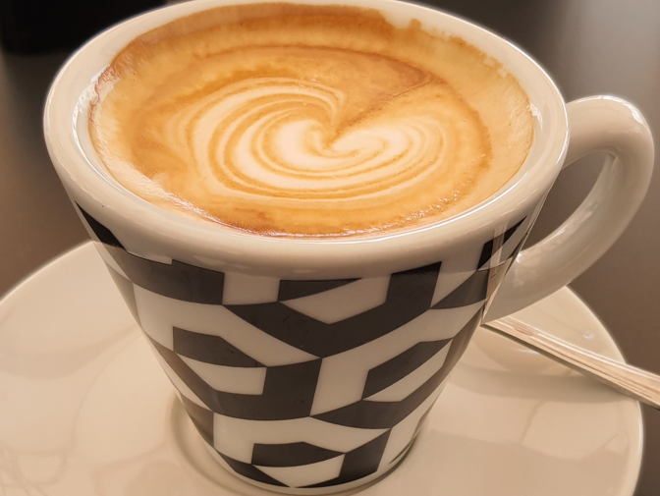
introduction | research: ItE | attitudes to features | learning & attitudes to text | conclusions
20/21
5. Conclusions
ItE presents special challenges, also in vowel spaces (cf. Albrecht, Schmied & Ivanova (2023)).
ItE is consistently ranked lower than AmE by Italians. Their own variety of English is not ranked positively by Italian university students. The ItE agent is nice, charming but not competent? No – neither – not accepted!
The perception of outsiders towards ItE may be much more positive, if it is associated with dolce vita, etc.
Further Research: In automatic/agent speech sample composition, distinguish between stereotypical markers and unnoticed features, maybe subconscious appreciation of “our English” without stereotypes.
Through a long tradition, availability of native speakers at Italian universities, the native-speaker ideal is still firmly rooted in Italian Universities.

Slide 21
References
introduction | research: ItE | attitudes to features | learning & attitudes to text | conclusions
21/21
Albrecht, S., Schmied, J., Ivanova, M. (2023). Comparing Vowel Spaces across Three Circles: a quantitative corpus-based Approach. IAWE25. Stony Brook, NY.
Andrist, S., Ziadee, M., Boukaram, H., Mutlu, B., & Sakr, M. (2015). Effects of culture on the credibility of robot speech: A comparison between English and Arabic. In Proceedings of the tenth annual ACM/IEEE international conference on human-robot interaction.
Boduch-Grabka, K., & Lev-Ari, S. (2021). Exposing individuals to foreign accent increases their trust in what nonnative speakers say. Cognitive Science, 45(11), e13064. https://doi.org/10.1111/cogs.13064
Défossez, A., Synnaeve, G., & Adi, Y. (2022). denoiser (Version 0.1.4) [Computer software]. facebookresearch. https://github.com/facebookresearch/denoiser
Delibegović Džanić, N., & Berberović, S. (2021). Lemons and watermelons: Visual advertising and conceptual blending. In L. D’Angelo, A. Mauranen, & S. Maci (Eds.), Metadiscourse in digital communication (pp. 115–132). Springer International Publishing. https://doi.org/10.1007/978-3-030-85814-8_6
Kachru, B. B. (1991). World Englishes: approaches, issues and resources. Language Teaching, 25(2), 1–14.
Karakaş, A. (2017). English voices in ‘Text-to-speech tools’: Representation of English users and their varieties from a World Englishes perspective. Advances in Language and Literary Studies, 8(5), 108. https://doi.org/10.7575/aiac.alls.v.8n.5p.108
Labov, W. (1994). Principles of linguistic change: Internal factors. Language in society: Vol. 20. Blackwell.
Pulcini, V. (1994). The English language in Italy. English Today 40,49-52.
Pulcini, Virginia (1995) Some new English words in Italian. Textus., English Studies in Italy VIII, 269-282.
Pulcini, V. (1997). Attitudes toward the spread of English in Italy. World Englishes 16,1, 77-85.
Rey, G. D., & Steib, N. (2013). The personalization effect in multimedia learning: The influence of dialect. Computers in Human Behavior, 29(5), 2022–2028. https://doi.org/10.1016/j.chb.2013.04.003
Sandygulova, A., & O’Hare, G. (2015). Children’s perception of synthesized voice: Robot’s gender, age and accent. In A. Tapus, E. André, J.-C. Martin, F. Ferland, & M. Ammi (Eds.), Social Robotics. 7th International Conference, ICSR 2015. Springer International Publishing.
Tamagawa, R., Watson, C. I., Kuo, I. H., MacDonald, B. A., & Broadbent, E. (2011). The effects of synthesized voice accents on user perceptions of robots. International Journal of Social Robotics, 3(3), 253–262. https://doi.org/10.1007/s12369-011-0100-4
Taubert, S. (2022a). tacotron-cli (Version 0.0.3) [Computer software]. https://github.com/stefantaubert/tacotron
Taubert, S. (2022b). waveglow-cli (Version 0.0.1) [Computer software]. https://github.com/stefantaubert/waveglow

Slide 22
IAWE 25
Stony Brook University
Empirical perception studies on Italian English: Neglected, charming or unaccepted?
Notes:
22

