Slide 1
mLearning for Palestine TISLID 22
mLearning for Palestine: Practical challenges in a project to “bridge educational and socio-political gaps” for university learning
Positive impacts of language technology: TISLID 22
Josef Schmied
Aydah Bakeer
Sven Albrecht

Slide 2
Introduction Challenges Quantitative Results Qualitative Results Outlook
1. Introduction: The ePAL Proposal
Quoting from Application Form 2018!! well before Corona Pandemic
E.4. Innovative Character
Teaching English as a Foreign Language in Palestinian HEIs: An e-Learning Initiative that Bridges Educational and Socio-Political Gaps “TEFL-ePAL”
The project aims to bring about major improvements in the design of flexible curricula, innovation, digital educational resources, infrastructure, teacher development, professional development, ...
Blended Learning and ICT integration increase student engagement through dynamic and fully interactive environment on the platform; students and instructors can share ideas, documents, host online courses, run training seminars, and give each other honest individual feedback ...
we were on the right track, we have achieved a lot
established a basis for continuous monitoring: are we always friendly, fair, flexible, facilitating, …
but we need to go faster and further
during the Covid-19 pandemic, the whole world had a “Palestine isolation experience” and will understand our efforts better

Slide 3
Introduction Challenges Quantitative Results Qualitative Results Outlook
1. Introduction: Activities
Plan:
“TEFL Roadmap will be followed to carry out the project activities: 1. Preparation, 2. Development, 3. Implementation, 4. Exploitation, 5. Management.”
Tangible outputs:
language labs in 5 Palestinian universities
English books from Pre-intermediate to Advanced level
related e-books with online exercises and links
Intangible outcomes:
change of teaching and learning culture (Palestinian developed with European advisors)
from traditional to 21st century teaching
from teacher- to student-centred instruction and much more
we report on the practical challenges illustrated from the learning materials developed in the project and quantitative and qualitative results

Slide 4
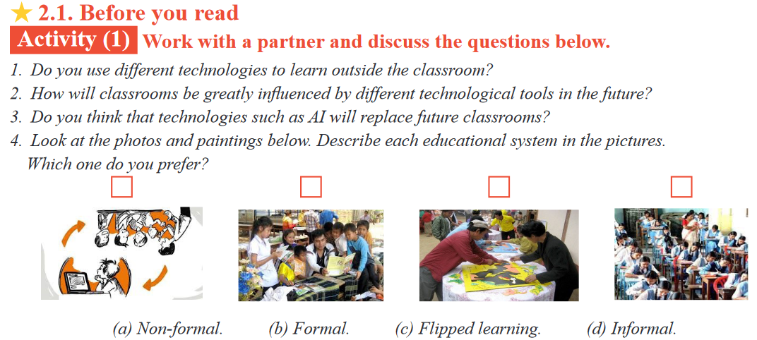
Introduction Challenges Quantitative Results Qualitative Results Outlook
2. Challenges: from teacher- to student-centered instruction
implies creating an awareness of different types of learning (Advanced English 2021: 124)

Slide 5
Introduction Challenges Quantitative Results Qualitative Results Outlook
2. Challenges: from passive consumer to autonomous learner
the autonomous learner can digest and evaluate information and learns to act in realistic situations
(Advanced English 2021:81 + 85)

Slide 6
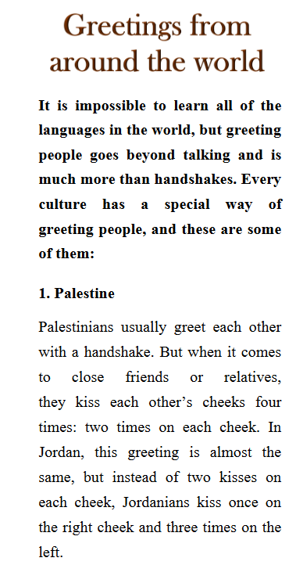
Introduction Challenges Quantitative Results Qualitative Results Outlook
2. Challenges: from Euro-centered to localized materials
Euro-centred to localised materials are part of the decolonialisation of learning
(Pre-intermediate English 2021: 4): 4)
but not all materials are local (and Ronaldo is mentioned more often than Saleh, Naguib Mahfouz as often as Mozart)
(Intermediate English1 2021:6 and 2021:36)

Slide 7
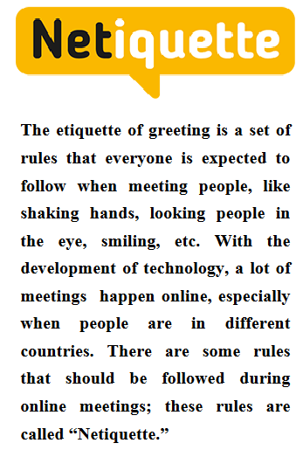
Introduction Challenges Quantitative Results Qualitative Results Outlook
2. Challenges: from Euro-centered to global materials
for Palestinians English is the window to the world and for global interaction and exchange
and this requires good online manners (Pre-intermediate English 2021: 15)
so local materials are integrated into global comparisons (even traditional preferences like food)
(Pre-intermediate English 2021: 24)

Slide 8
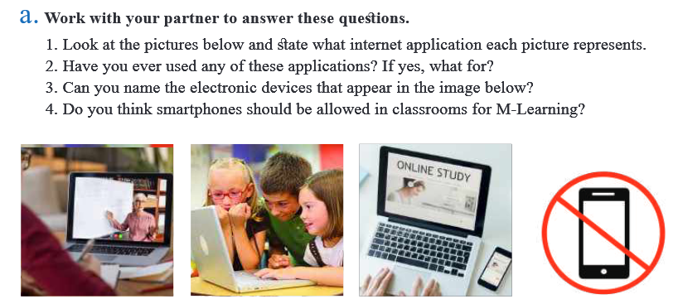
Introduction Challenges Quantitative Results Qualitative Results Outlook
2. Challenges: from mobiles for fun to mobiles for work
mobile phones for fun and communication are common among students all over the world, integrating mobile phones for work and learning are an extra effort - and still, in some classes mobile devices are forbidden!
(Intermediate English2 2021: 36)

Slide 9
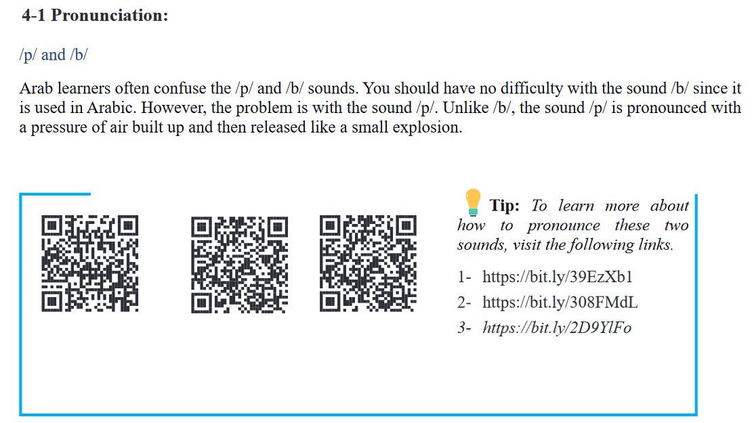
Introduction Challenges Quantitative Results Qualitative Results Outlook
2. Challenges: from isolated to internet integrated materials
integrated QR code lead students to multimodal materials produced in the project and available on the Internet
(Intermediate English1 2021:14)

Slide 10
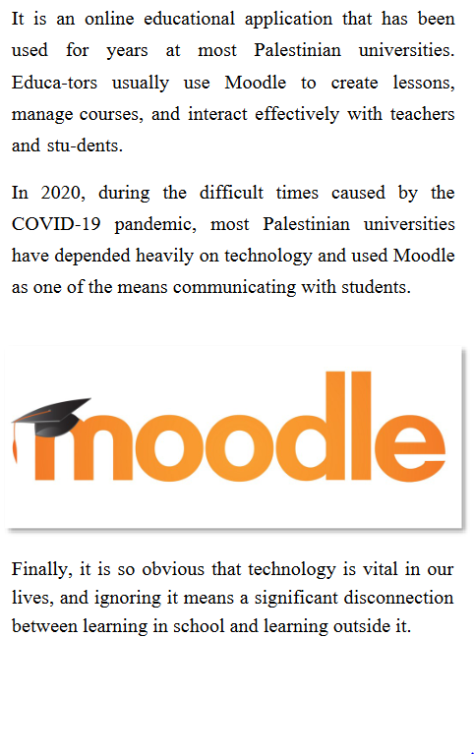
Introduction Challenges Quantitative Results Qualitative Results Outlook
2. Challenges: from proprietary thinking to open resources
from proprietary thinking to open educational resources
(Pre-intermediate English 2021: 75)

Slide 11
Introduction Challenges Quantitative Results Qualitative Results Outlook
2. Challenges: from traditional roles as content developers vs. technical to integrated social learning facilitators
from traditional roles as content developers vs. technical developers to integrated social learning facilitators.
(Advanced English 2021: 124) (Advanced English 2021: 124)

Slide 12
Introduction Challenges Quantitative Results Qualitative Results Outlook
3. Quantitative Results
Group | N | Mean | Std. Dev. | Std. Error Mean | Sig*
Pre-test Post-test | 250 245 | 3.5705 3.6263 | .31910 .32085 | .02018 .02107 | .682
Table 1: Results of Paired t-test for Equality of Means of Students’ Attitudes Toward LEFL for the Experimental and the Control Groups in the Pre-test
Group | N | Mean | Std. Dev. | Std. Error Mean | Sig*
Pre-test Post-test | 245 245 | 3.5419 3.7263 | .31852 .32985 | .02035 .02107 | .000
Table 2: Results of paired t-test for Equality of Means of Students’ Attitudes Toward LEFL for the Experimental and the Control Groups in the Post-test

Slide 13
Introduction Challenges Quantitative Results Qualitative Results Outlook
3. Quantitative Results
Total | Sum of Squares | df | Mean Square | F | Sig.
Between Groups Within Groups Total | .144 26.403 26.547 | 2 242 244 | .072 .109 | .659 | .518
Table 3: Results of One Way ANOVA for Students’ Attitudes towards Learning EFL based on Age
Total | t | df | Mean Square | F | Sig.
Equal variances Equal variances not assumed | 1.729 1.293 | 243 54.424 | .072 .109 | 9.632 | .085 .201
Table 4: Results of One Way ANOVA for Students’ Attitudes toward Learning EFL based on Residence
Total | t | df | Mean Square | F | Sig.
Equal variances Equal variances not assumed | 1.729 1.293 | 243 54.424 | .072 .109 | 9.632 | .085 .201
Table 5: Results of One Way ANOVA for Students’ Attitudes toward Learning EFL based on Gender

Slide 14
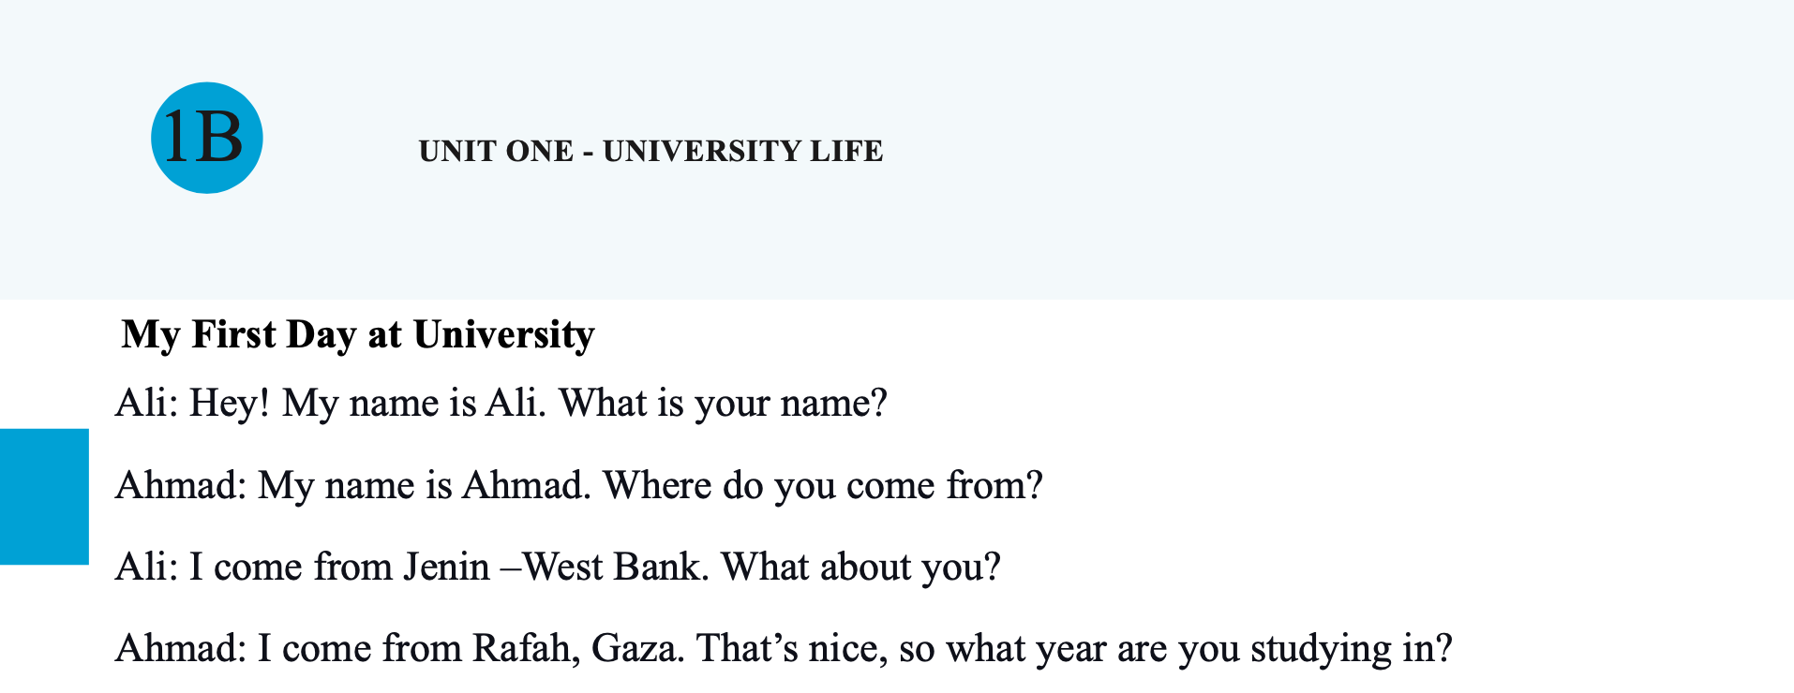
Introduction Challenges Quantitative Results Qualitative Results Outlook
4. Qualitative Results: Adaptation to the Palestinian Context
Cultural background
Names
Events
Famous people
Notes:
Books, adaptations to Palestine, social media interest of students (incl. Book screenshot) – 2 slides

Slide 15
Introduction Challenges Quantitative Results Qualitative Results Outlook
4. Qualitative Results: Adaptation to Student Interests
Covers all four skills
Relevant to students’ daily life
Practical knowledge apart from language
Notes:
Books, adaptations to Palestine, social media interest of students (incl. Book screenshot) – 2 slides

Slide 16
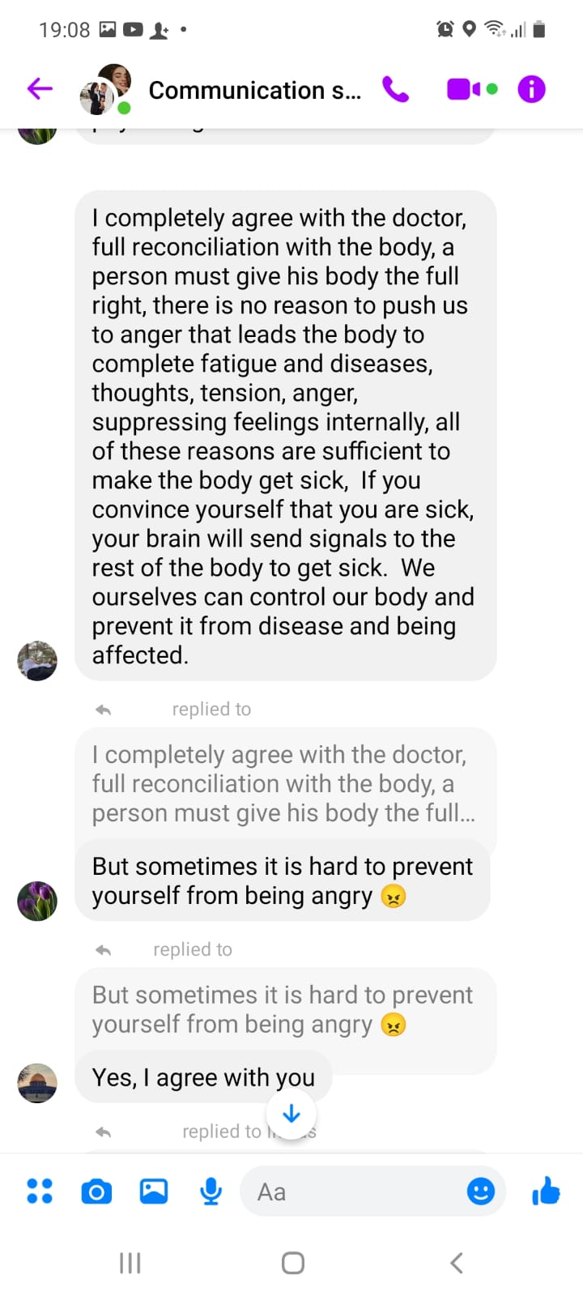
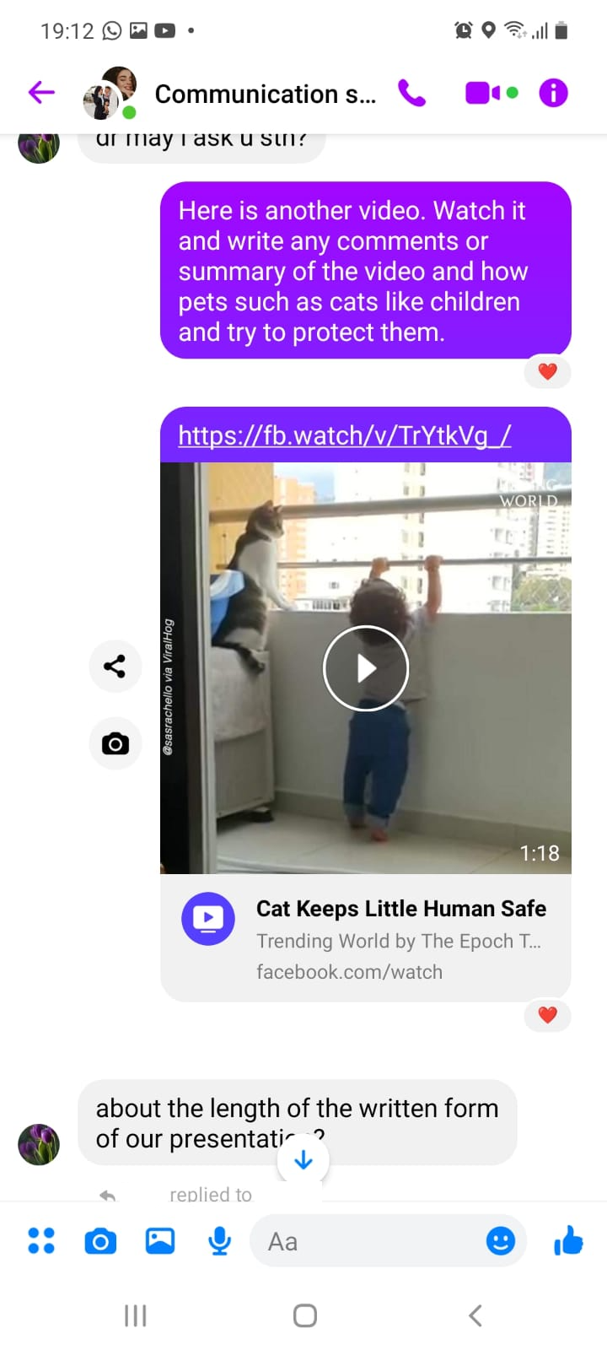
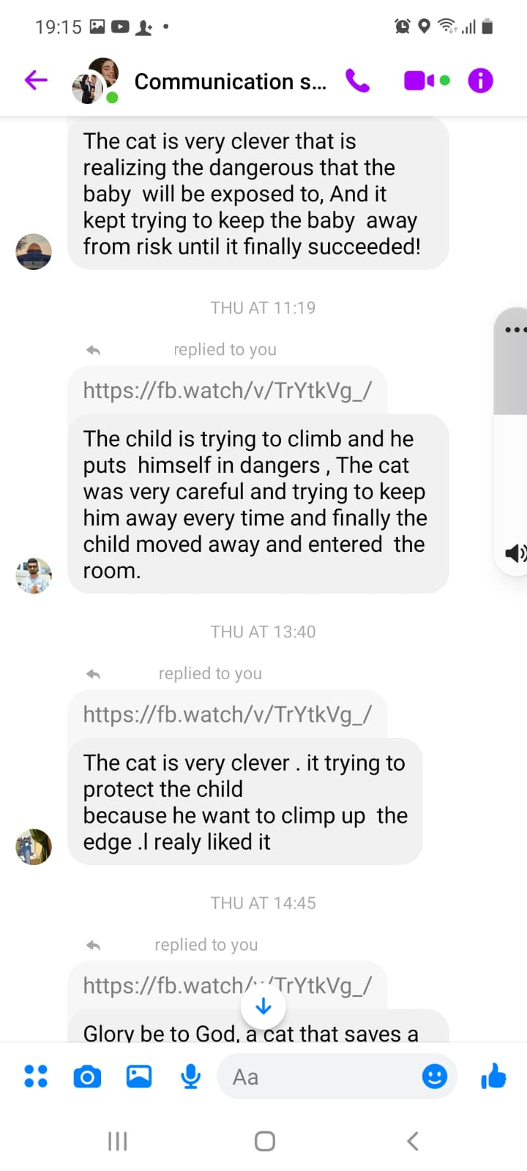
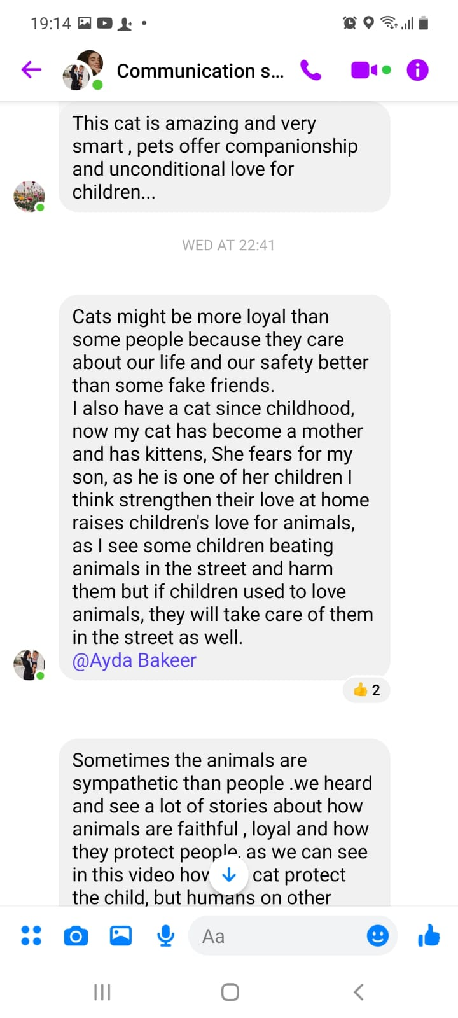
Introduction Challenges Quantitative Results Qualitative Results Outlook
4. Qualitative Results: Interaction
Even cute videos of cats can facilitate student interaction.
Students reply to prompts provided by teacher.
Students reply to responses by peers.
Notes:
Interaction (screenshots moodle/whatsapp) – 1 slides -> Ask Aida

Slide 17
Introduction Challenges Quantitative Results Qualitative Results Outlook
4. Qualitative Results: Social Learning
Students create videos as communication prompts
Other students can react and reply, both in class and out of class
Improvement through newly developed curricula evident
Notes:
Integrated social learning facilitators (student uploaded videos etc. other students comment)

Slide 18
Introduction Challenges Quantitative Results Qualitative Results Outlook
4. Outlook
Achievements
Four new courses and accompanying text books
LMS established at all Palestinian partner universities
Language labs at all Palestinian partner universities
OER bank that all partners can access
Training of Trainers cascading scheme established
All teaching materials are now available online, even on mobile devices
Notes:
Incl. Sustainability, maybe focus on mobile use

Slide 19
Introduction Challenges Quantitative Results Qualitative Results Outlook
4. Outlook
Possible future collaborations
Digital literacy and privacy awareness
Digital sustainability and independence
Improving pre-university English education
Notes:
Incl. Sustainability, maybe focus on mobile use

Slide 20
Introduction Challenges Quantitative Results Qualitative Results Outlook
References
The developed textbooks are available for download from this page: https://www.tu-chemnitz.de/phil/english/sections/ling/TEFL-ePal/TEFL-ePal.php

Slide 21
mLearning for Palestine
mLearning for Palestine: Practical challenges in a project to “bridge educational and socio-political gaps” for university learning
Josef Schmied
Aydah Bakeer
Sven Albrecht

