Slide 1
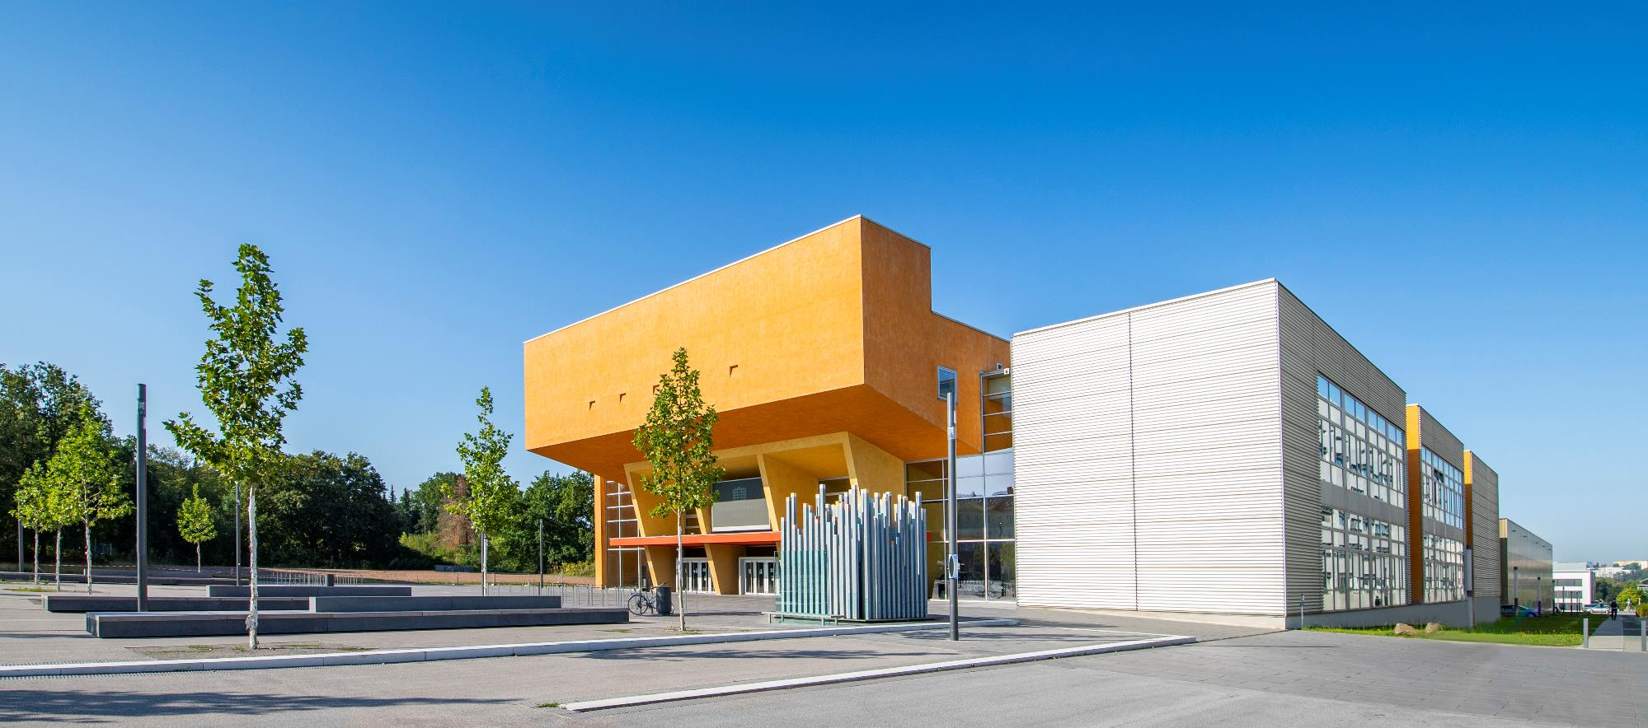
Brief Profile of Chemnitz University of Technology

Slide 2
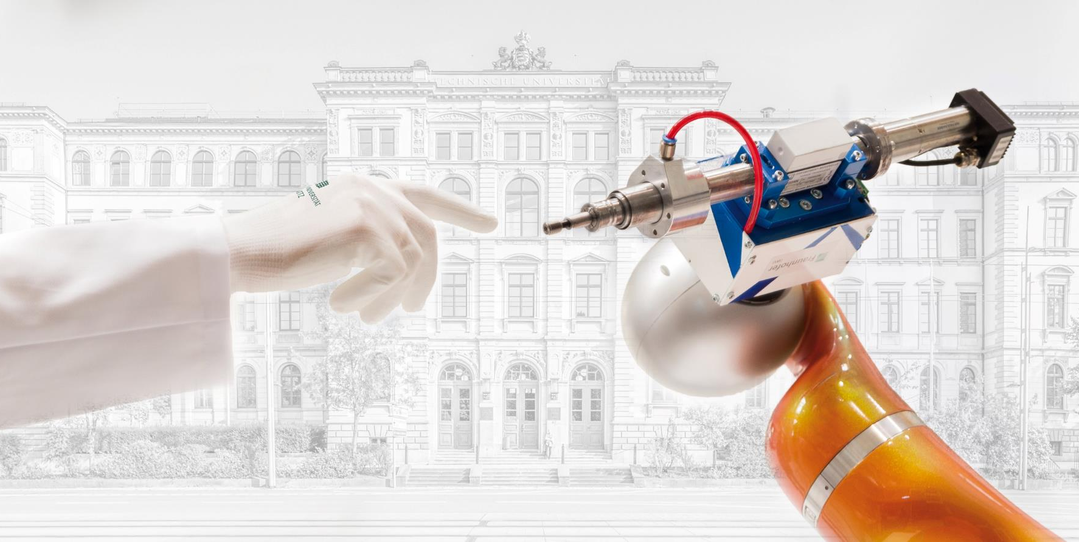
Brief Profile of Chemnitz University of Technology
Foto: Steve Conrad, Jacob Müller

Slide 3
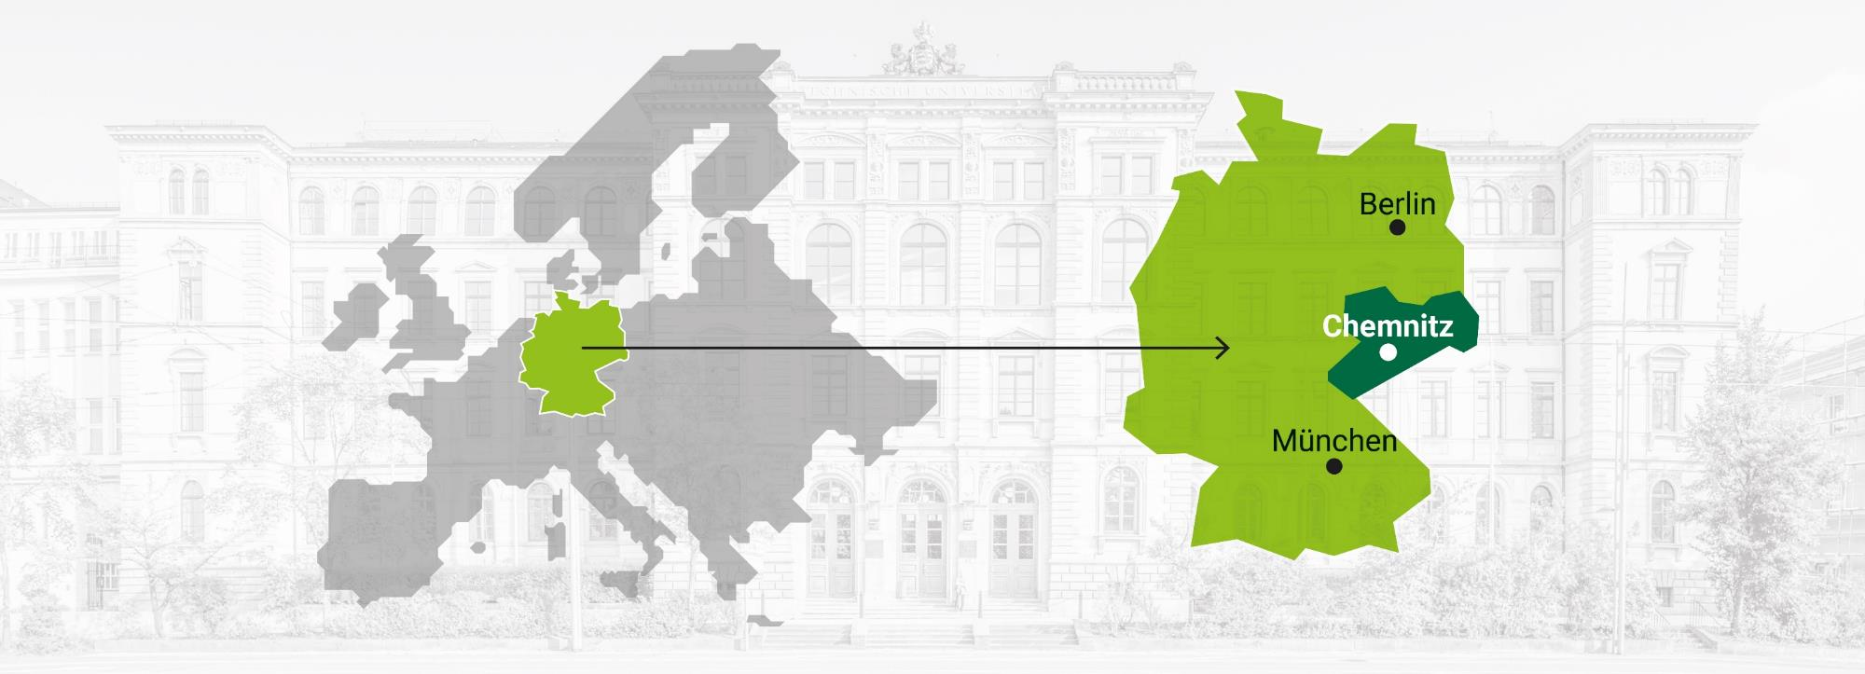
Chemnitz
Above-average economic growth
Above-average share of innovative jobs
Above-average share of industry in added-value creation

Slide 4
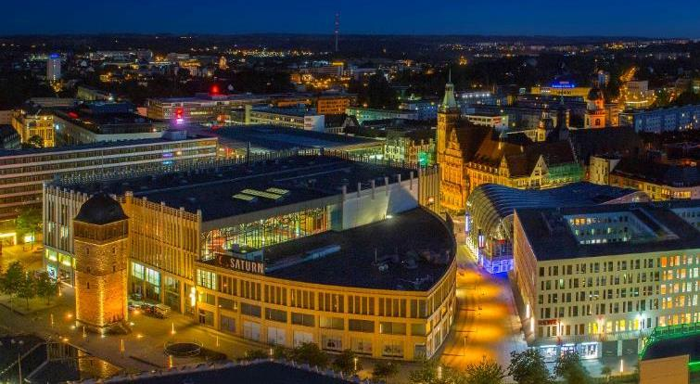
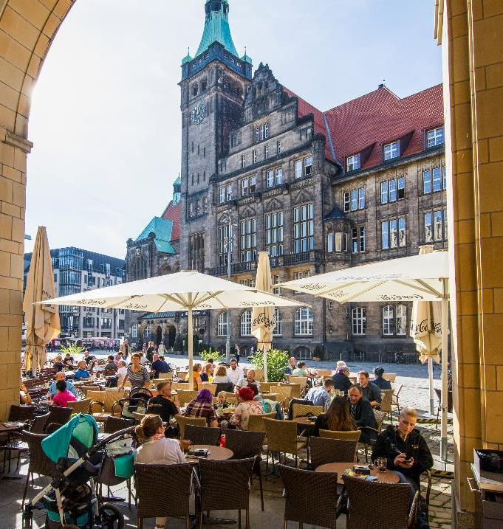
Chemnitz – City of Modernity
250,160 residents (13.1 percent foreigners)
More than 18,500 companies. 7,000 of those founded after 1995
Traditional strengths: mechanical and plant engineering, automotive industry, microsystem technology
status: 2023

Slide 5
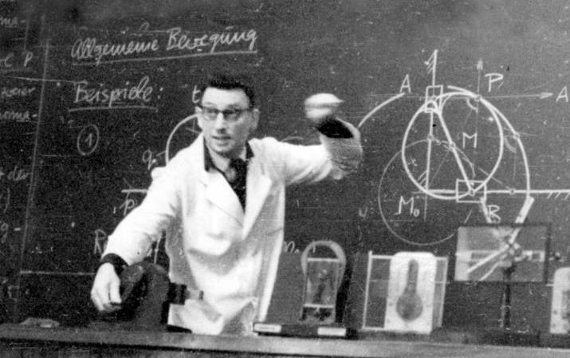
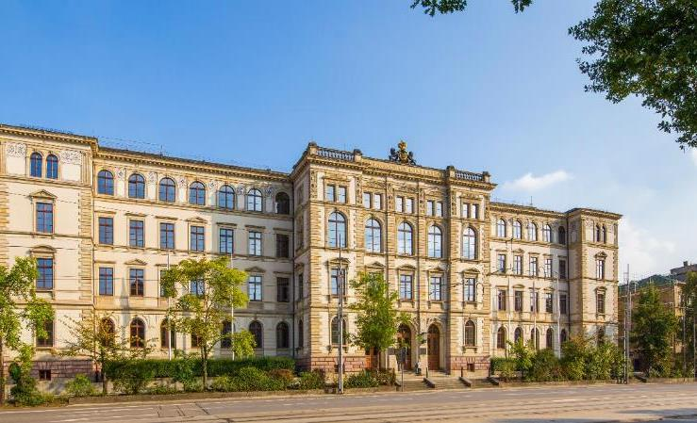
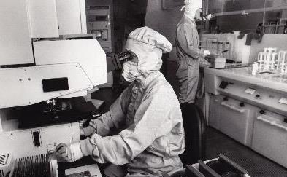
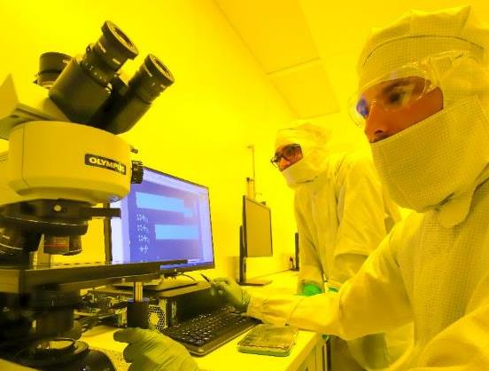
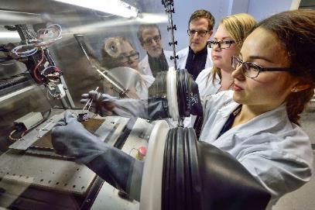
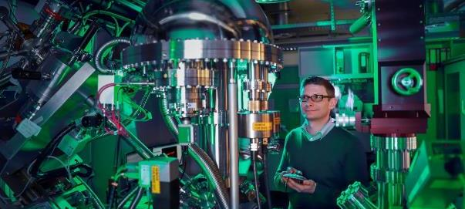
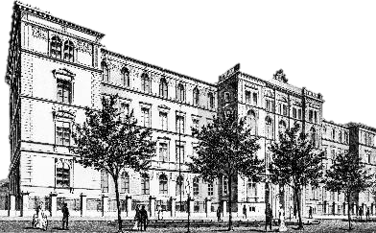
History of Chemnitz University of Technology
Foto: Wolfgang Thieme;
1836 Royal Industrial School Chemnitz Founded
1953 New University of Mechanical Engineering Karl Marx Stadt Founded
1986 “University of Technology” status awarded

Slide 6
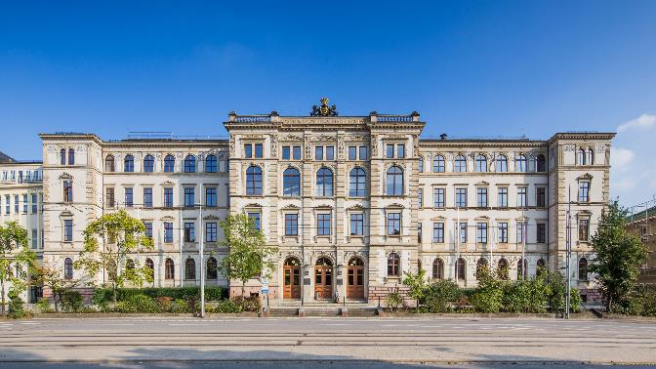
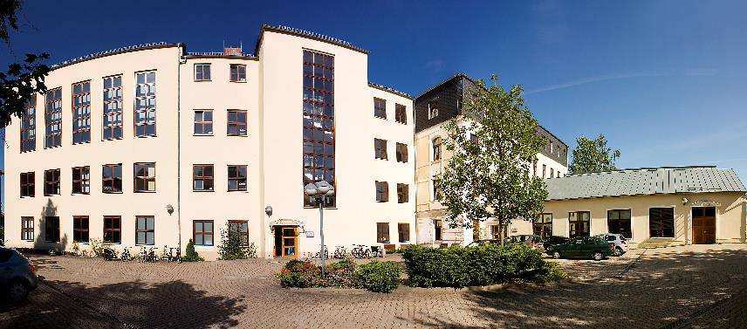
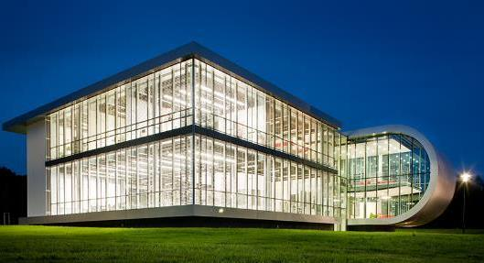
University Locations
Foto: Steve Conrad
Campus Reichenhainer Straße
Foto: Jürgen Lösel
Straße der Nationen
Wilhelm Raabe Straße
Erfenschlager Straße

Slide 7
Facts and Figures
96 Degree Programs
were offered by the 8 faculties and the Center for Teaching Traning during the 2022/2023 winter semester, including
33 Bachelor‘s and 59 Master‘s programs, 2 Diploma programs, and
2 Programs at the Center for Teacher Training.
9,481 Students
were enrolled in the 2022/2023 winter semester, including 4,367 women.
International students from 87 countries comprised 31.6% of the student population at Chemnitz University of Technology in 2022.
169 Professorships
(including 9 at the Center for Teacher Training) in 2022, complemented by 9 additional junior professorships.
2,293 Employees
About 43 % were supported by third-party funding.
1,589 Graduates completed their studies in the 2022 academic year at Chemnitz University of Technology
121 Doctorates und 7 Habilitations completed in 2022
status: 2023

Slide 8
Facts and Figures
3 Core Competencies
concerned with the important questions of tomorrow: Materials and Smart Systems, Resource-efficient Production and Lightweight Construction as well as Human and Technology.
1.2 Million Printed Books and Magazines as well as 377,000 digital holdings were offered by the university library in 2022
1,286 Projects
received third-party financing in 2022.
18 Enterprises
were spun off in 2022 with support from the university, the SAXEED start-up network, and the TUClab. In addition, 57 other projects are being advised in Chemnitz.
103,9 Million Euros
received by the university as a state grant in 2022.
88 Million Euros in Third-Party Funding
were raised by university researchers in 2022.
1,462 Publications
from the university community were published in 2022 and are available in the University Bibliography.
status: 2023

Slide 9
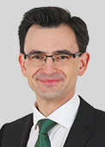
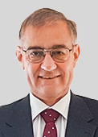
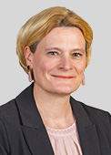
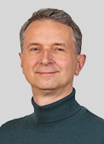
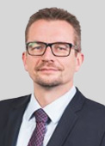
University Leadership
Prof. Dr.
Gerd Strohmeier
President
Prof. Dr.
Uwe Götze
Vice President for Transfer and Academic Qualification
Prof. Dr.
Anja Strobel
Vice President for Research and University Development
Prof. Dr.
Maximilian Eibl
Vice President for Academic and International Affairs
Thomas Lang
Acting Chancellor

Slide 10
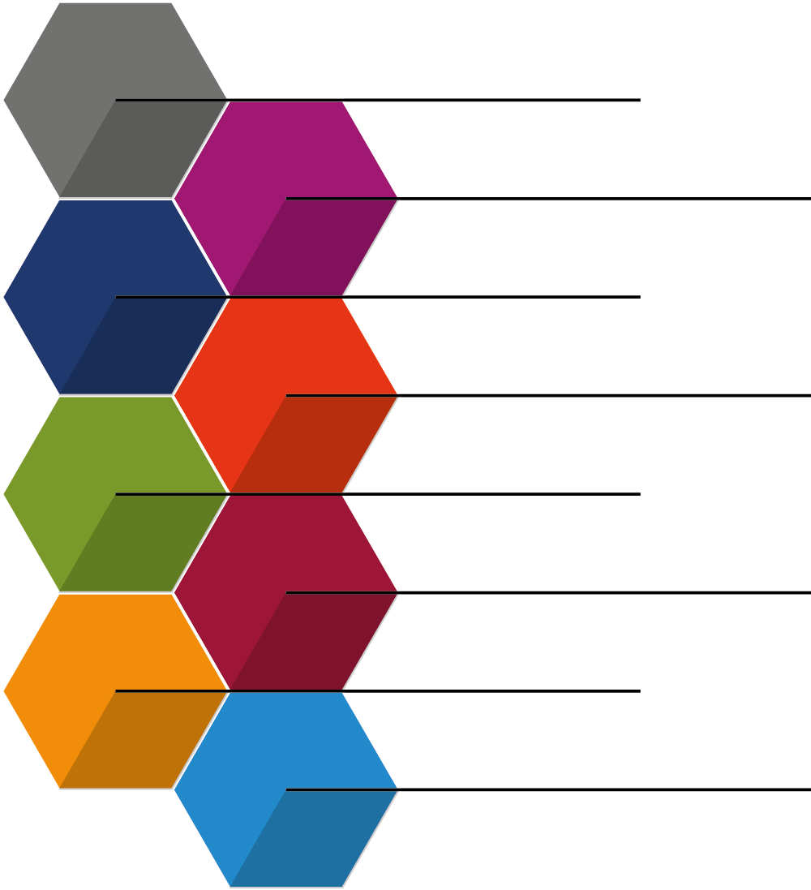
Faculties
Faculty of Natural Sciences
Faculty of Mathematics
Faculty of Mechanical Engineering
Faculty of Electrical Engineering and Information Technology
Faculty of Computer Science
Faculty of Economics and Business Administration
Faculty of Humanities
Faculty of Behavioral and Social Sciences

Slide 11
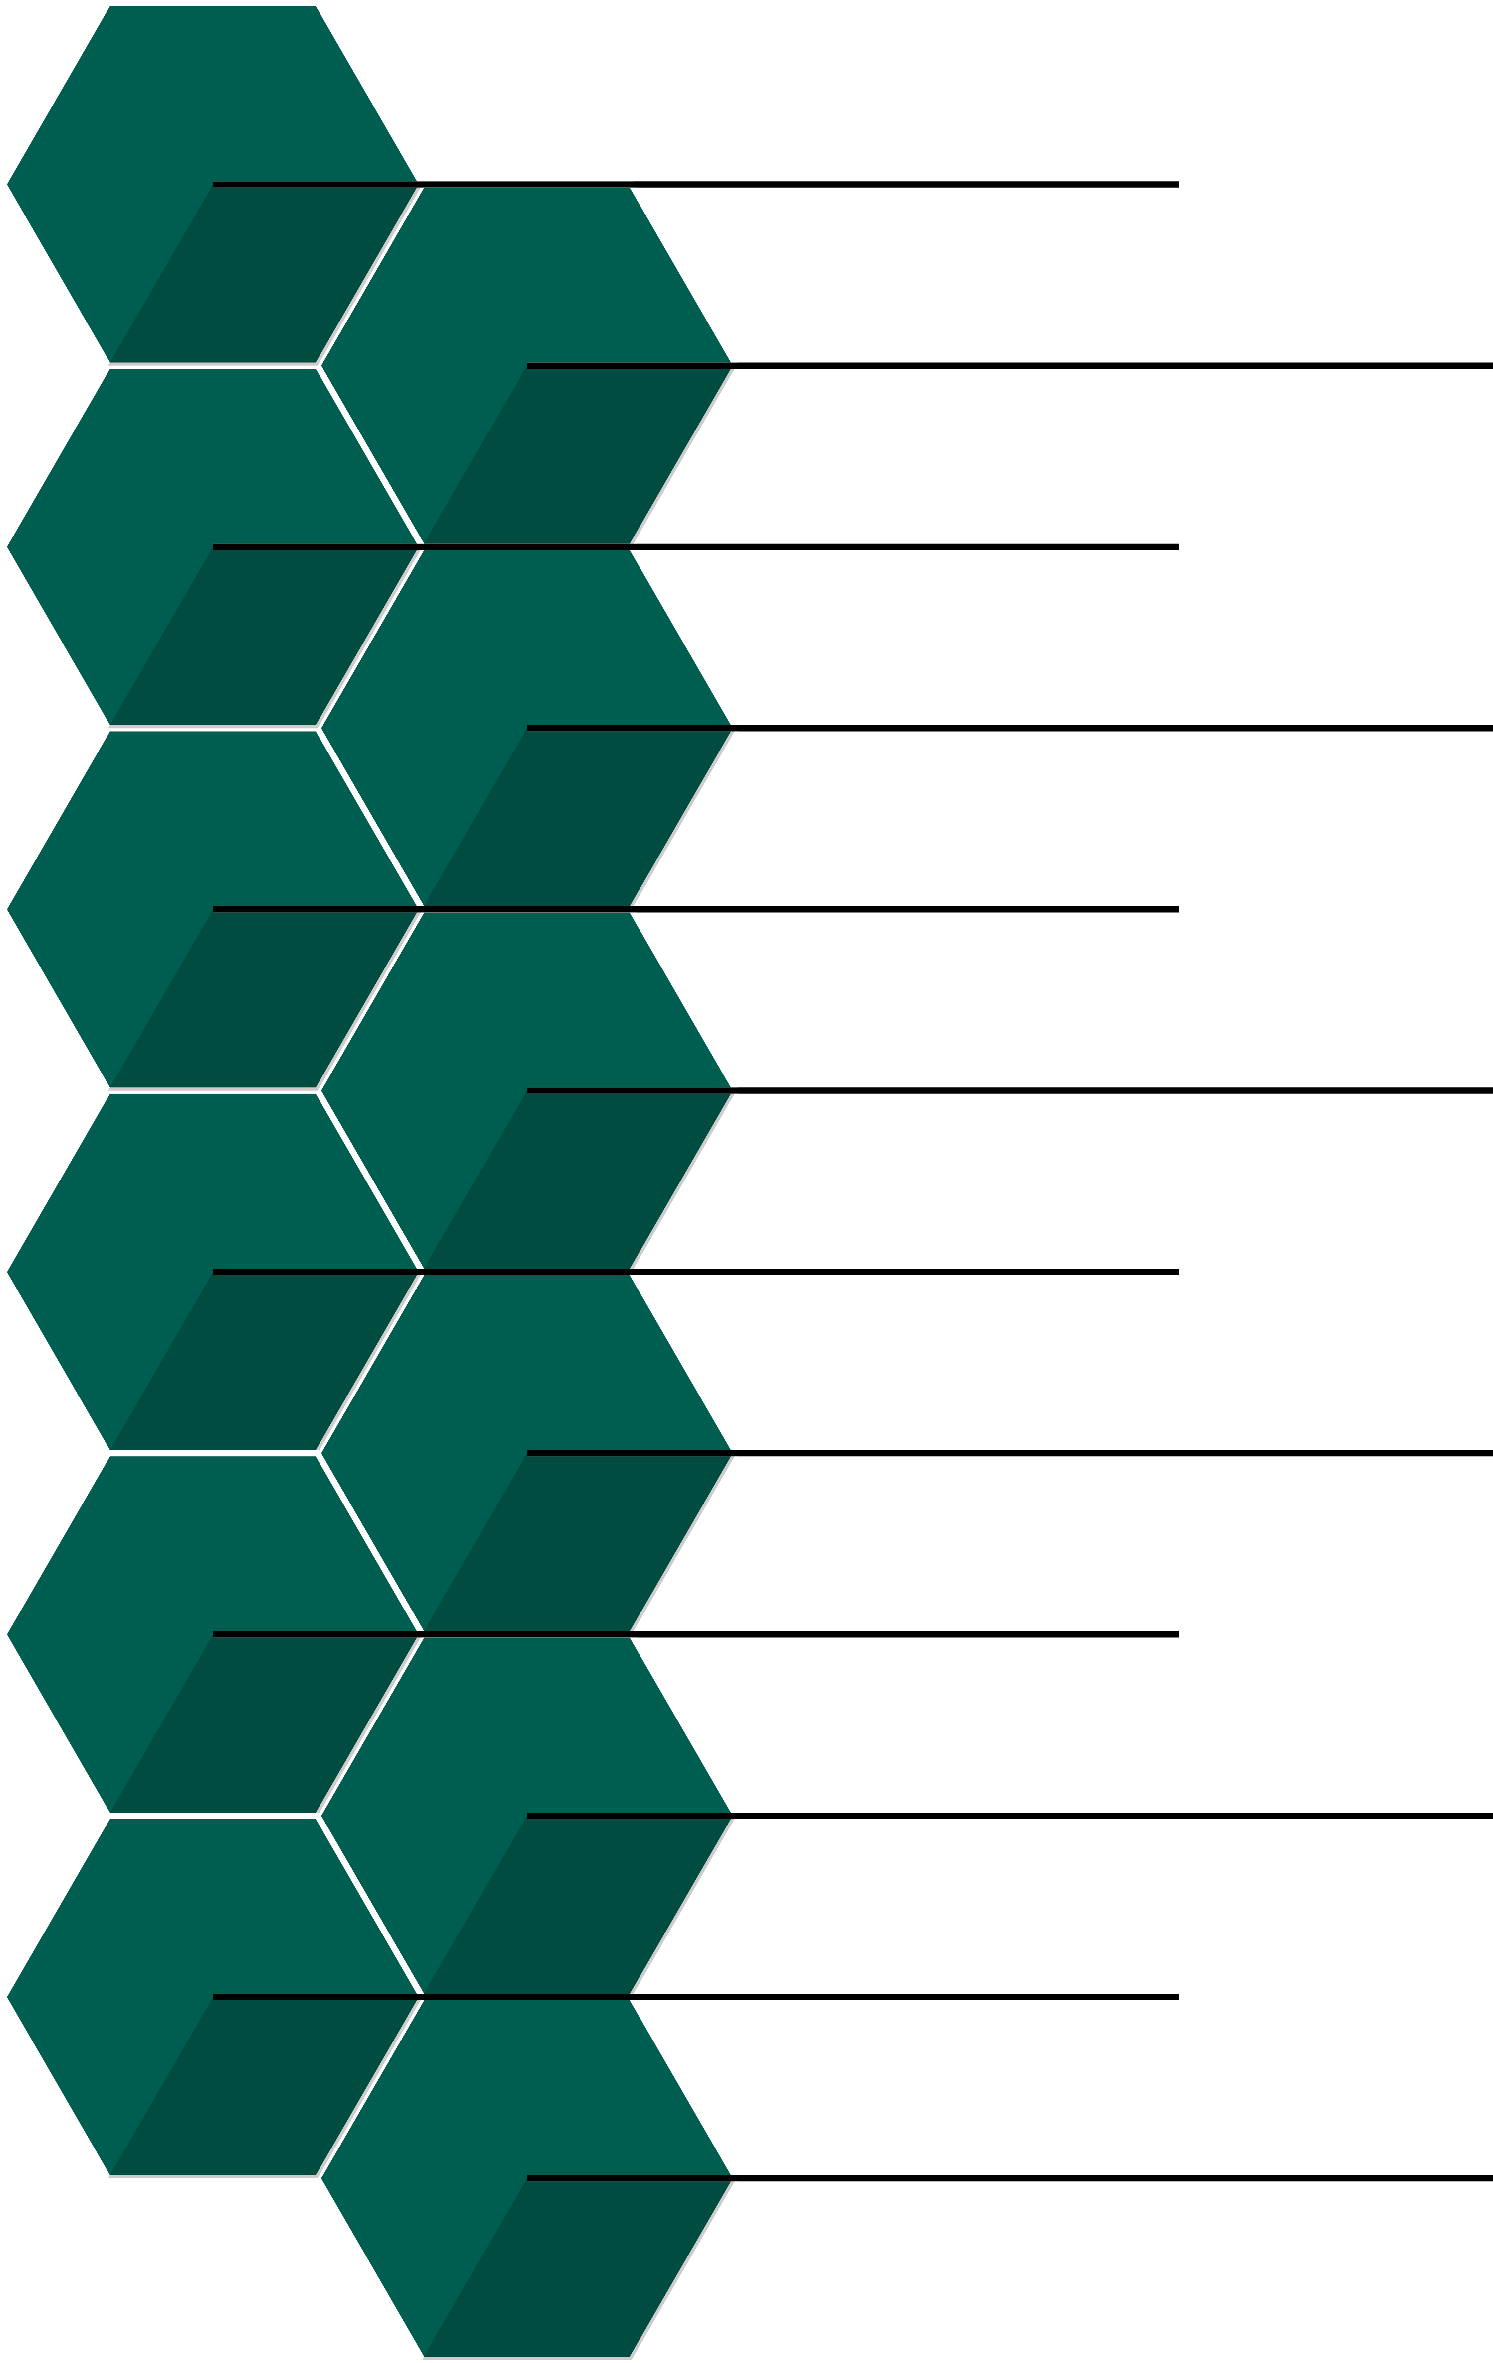
Central Institutions
Cluster of Excellence MERGE
Center for Teaching and Learning Saxony
International Office
University Library
University Computer Center
Foreign Language Center
Center for Teacher Training
Center for Young Scientists
Center for Knowledge and Technology Transfer
Center for Sports and Health Promotion
Research Center MAIN
Zentrum für Mensch und Technik (de)

Slide 12
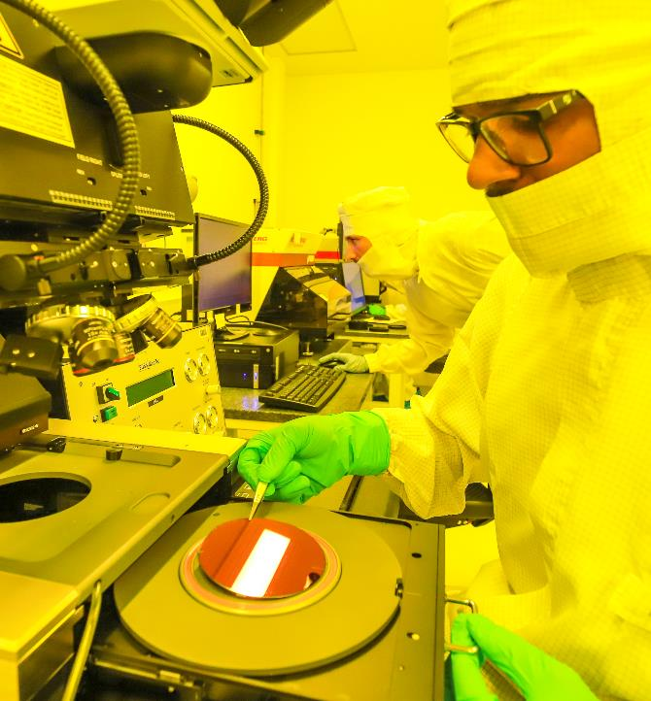
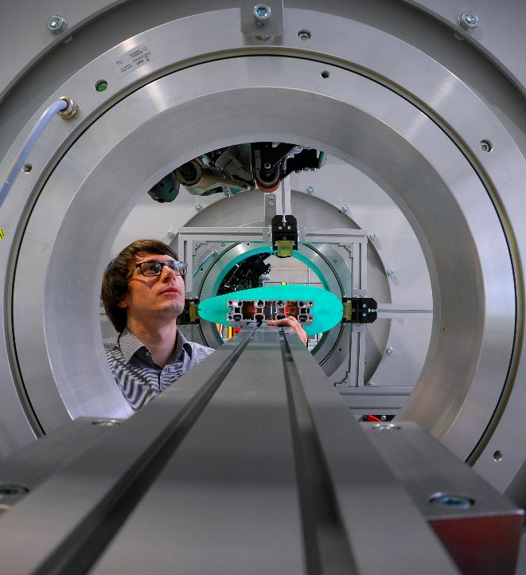
Core Competencies
Materials and Smart Systems
Resource-efficient Production and Lightweight Construction
Human and Technology

Slide 13
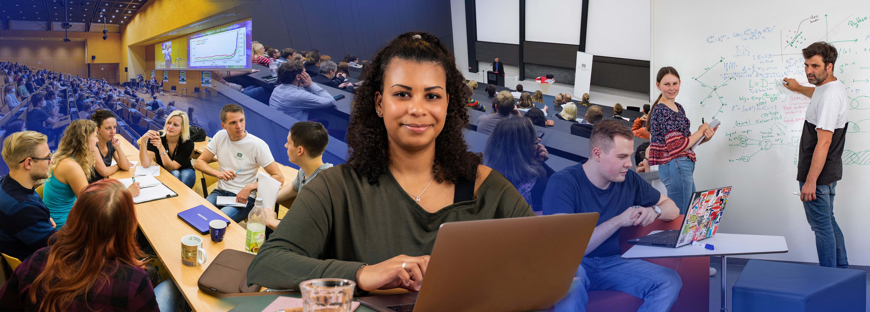
Teaching
Internationalization
Research-based learning
Cross-disciplinary
Application oriented
33 Bachelor’s Programs | 59 Master’s Programs | 2 Diploma Programs
2 Programs at the Center for Teacher Training
14 Part-Time Distance and Continuing Training Programs
status: 2023

Slide 14
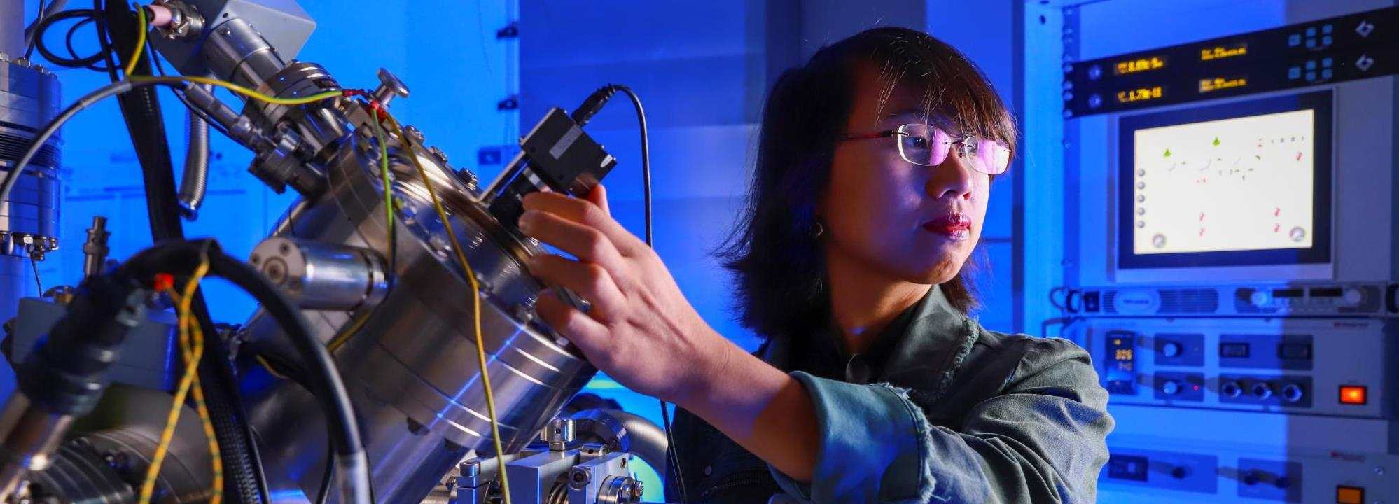
Internationalization
31.6% international students
Students from 87 countries
Partnerships with more than 160 universities worldwide

Slide 15
Young Scientists
Foto: Wolfang Schmidt
Center for Young Researchers
Optimal working conditions
Cross-disciplinary continuing education during doctoral studies and habilitation
Cross-disciplinary advising
Individual support during challenging phases
Networking for cross-disciplinary exchanges
Support for career goals and development

Slide 16
Knowledge and Technology Transfer
Technology Scouting
Spin-offs
Continuing Education
Project advising and support, technology scouting, and spin-offs
Advice on transfer, economic value, and patent applications
Specialist placement
Continuing and part-time education
Cross-generational educational programs

Slide 17
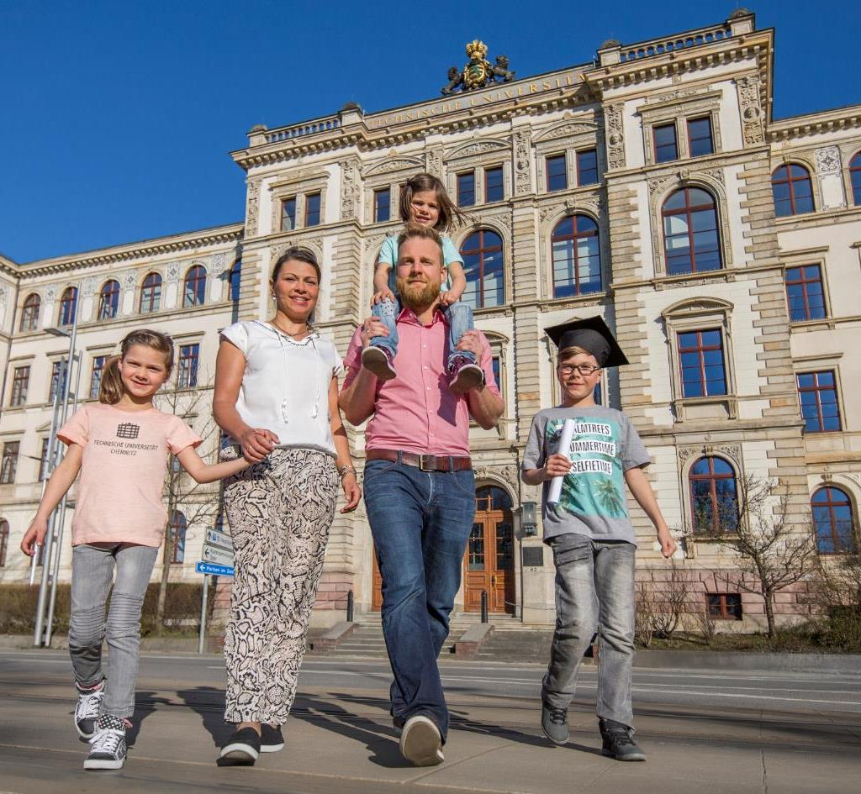
Equal Opportunities and Balancing Work, Studies, and Family
Cornerstones
Promoting women as an integral component of the human resources department
Center for Equal Opportunities in Science and Research
Research-oriented equality standards from the German Research Foundation
Permanent designation as “Family-Friendly University”
Measures
Successful participation in the Federal Ministry of Education and Research’s Female Professor Programs I and II
Tandem programs
Re-entry scholarships
Coordinator for equal opportunities within research networks
Family service

Slide 18
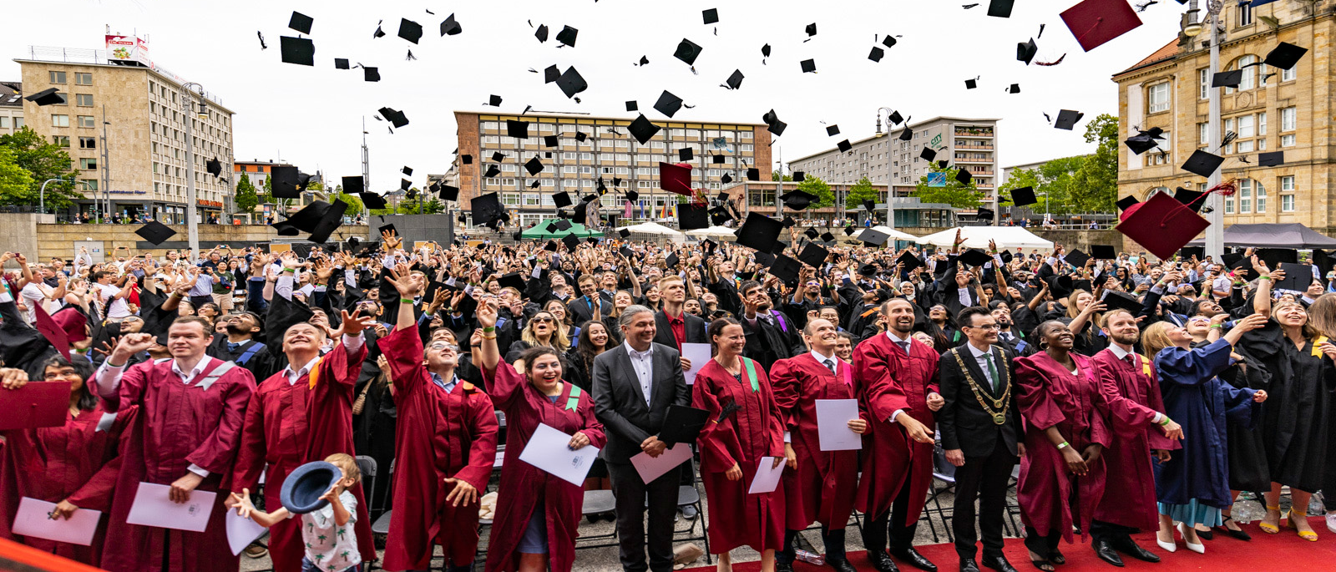
Network of Disseminators at Chemnitz University of Technology
Chemnitz University of Technology sent off its graduates during the commencement ceremony. 1,568 students graduated from Chemnitz University of Technology in 2022.

